Slide 1
Wi-Fi automation lab Lab Guide - Day 2
Andreas Koksrud / Telenor Bedrift
Co-authors:
Kjetil Teigen Hansen & François Vergès

Slide 2
References / inspiration
References
https://github.com/CiscoDevNet/yangsuite/
https://postman.com
https://docs.ansible.com/ansible/latest/collections/cisco/ios/ios_facts_module.html
https://www.wifireference.com/2020/01/14/viewing-network-telemetry-from-the-catalyst-9800-with-grafana/
https://grafana.com/grafana/dashboards/13462-device-health-monitoring/
https://grafana.com/grafana/dashboards/12468-catalyst-9800-client-stats/
https://wirelessisfun.wordpress.com/2020/12/10/network-telemetry-data-and-grafana-part-1-the-advanced-netconf-explorer/
https://python.org
https://codeium.com
https://canonical.com/multipass
https://blog.apnic.net/

Slide 3
Copyright
Copyright
© Andreas Koksrud 2025. All rights reserved. This presentation is provided for educational and informational purposes only. You may distribute and learn from this presentation, but commercial use or any form of monetization is strictly prohibited without prior written consent
Any slides marked Kjetil Teigen Hansen or the Conscia logo will also have full or co-ownership by Kjetil
Any slides marked François Vergès or the SemFio logo will also have full or co-ownership by François

Slide 4
Prerequisites
Prerequisites
Cisco Meraki account (https://dashboard.meraki.com)
Juniper MIST account (https://manage.mist.com)
Postman account (https://postman.com)
Complete the pre-lab exercises (this document) before the deep dive labs
Bring an Ethernet dongle if you don't have built-in port
(optional) Bring an extra screen to show lab guide (or prepare to Alt-Tab)

Slide 5

Communications
Communications
WebEx space: Wi-Fi automation lab
Please help each other
Sharing is caring ☺

Slide 6
Agenda
Agenda
Pre-lab
Choose your hypervisor
Install Ubuntu Server w/Docker
Install Postman
Install VS Code
Day 1
Day 2
In-depth explore a topic of choice
Sort out pre-lab task problems
Grafana / TIG-stack
Grafana Cloud
Ansible
Python
Cloud vendor automation (MIST or Meraki)
Get to know the lab environment
Connect VS Code to Ubuntu
Install and explore Ansible
Explore Python automation
Install and explore YANG Suite
Explore Postman
Install and explore Grafana
(optional) install 9800-CL

Slide 7
Scope
Scope
In scope
Getting started with various systems/languages/solutions for lab purposes
Set up your own Ubuntu Linux server on your own laptop. It will be possible to use a shared server if you do not want or have possibility to install an Ubuntu VM on your laptop
Some nice examples to try various aspects of automation
Inspiring you to explore deeper on your own
Out of scope topics
Git
Learning the languages (Ansible, Python, InfluxQL, etc)
Learning Linux
Deploying the systems for production use
Troubleshooting WLC/AP connection

Slide 8
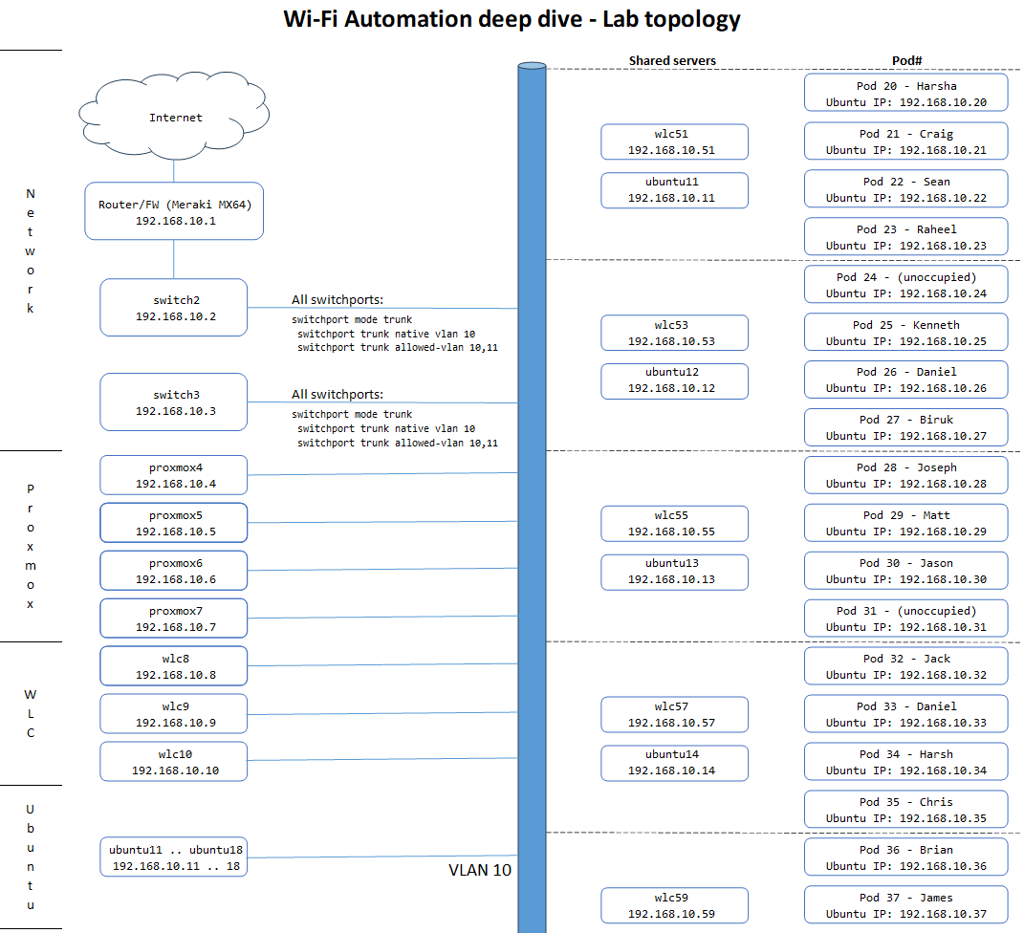
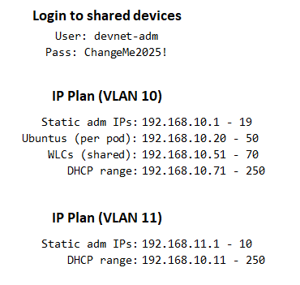
Lab topology
Each student have an assigned Pod number. When using static IP, their Ubuntu Server should have the same last octet as the Pod#
2 students share a preconfigured WLC, as assigned in the topology map
Everyone is connected to VLAN 10
All switchports on all switches are trunk ports with VLAN 10 as native, and allowed vlan as VLAN 10 and 11
For Wi-Fi clients on your SSIDs you can use VLAN 11 to not fill up VLAN 10

Slide 9
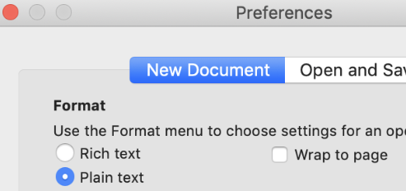
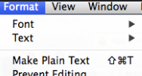
Notes for Mac users - TextEdit
Notes for Mac users
TextEdit (the default text editor on OS X) use rich text formatting by default. This is not a great idea when copy-pasting stuff to the command line, so there is a couple of things you must keep in mind
If you want, you can change a setting in TextEdit to make all new documents plain text
To change the current document to plain text go to Format -> Make Plain Text
Shortcut is: Shift-Cmd-T

Slide 10
About Day 2
About day 2
In-depth exploration of one or more topics of your choice
You should have completed relevant parts of Pre-lab tasks and Day 1 exercises
For each exercise, we will try to do the following
Tasks
One or more slides, with one or more tasks
Expected output
Hints
One or more slides, with hints or code snippets to get you in the right direction
Example solution
An example solution (Note that most exercises will have many possible solutions that are better than the example ☺)
Example output
Error handling
Examples in this lab will have minimal error handling to keep the examples small and readable
Depending on the usage (one-off vs. a recurring operations script) you will want some error handling

Slide 11
In-depth: Ansible
In-depth: Ansible
This part of the Day 2 labs will focus on using Ansible
The following lab exercises are included in this part
Lab Exercise #20: Ansible - Run CLI commands
Lab Exercise #21: Ansible - CLI configuration
Lab Exercise #22: Ansible - Using Jinja2 templates
Lab Exercise #23: Ansible - Using RESTCONF
Lab Exercise #24: Ansible - Writing your own module using Python
Lab Exercise #25: Ansible - Using RESTCONF + Python-module
Lab Exercise #26: Ansible - Organizing projects using import_playbook
Lab Exercise #27: Ansible - Organizing projects using roles

Slide 12
Run a CLI command - Intro
Lab Exercise #20: Ansible - Run CLI commands
In this exercise we will write a playbook that runs a single command on our WLC
We will observe that the output of the CLI command is passed back to the playbook, and can be used in further tasks
For this exercise, the output will be used in a task that prints the result of the CLI command out to the terminal where you ran the playbook

Slide 13
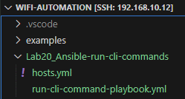
Run a CLI command - Tasks
Lab Exercise #20: Ansible - Run CLI commands
Task 0: Set up the files and folders and VS Code
Create a working directory
Create a playbook file
Remember to activate the automation-venv
Task 1: Write a playbook that
Runs the command "show wireless summary | inc Max APs"
Output when running this on the WLC should be like this
Task 2: Run the playbook on your WLC
You can copy the inventory file hosts.yml from Day 1
devnet-adm@ubuntu-devnet:~/wifi-automation/Lab20_Ansible-run-cli-commands$ source ~/automation-venv/bin/activate
(automation-venv) devnet-adm@ubuntu-devnet:~/wifi-automation/Lab20_Ansible-run-cli-commands$ ansible --version
wlc9# show wireless summary | inc Max APs
Max APs supported : 100
hosts.yml
wlc:
hosts:
192.168.10.{WLC-IP}:
vars:
ansible_connection: network_cli
ansible_network_os: ios
ansible_ssh_pass: restconf-pass
ansible_password: restconf-pass
ansible_user: restconf-adm
ansible_host_key_checking: False

Slide 14
Run a CLI command - Hints
Lab Exercise #20: Ansible - Run CLI commands
Playbook header
name: Name of the playbook, make it descriptive
hosts: The "wlc" here you can find in the hosts.yml file. Can be expanded to other types.
connection: network_cli for most of our stuff
gather_facts: A general-purpose gathering function
Our "tasks" section starts here
Instead of this placeholder, you would use a module that can run CLI commands. Try looking in the cisco.ios collection in the Ansible Docs https://docs.ansible.com/ansible/latest/collections/cisco/ios/index.html#plugins-in-cisco-ios
Instead of this placeholder, you will use a module that can output stuff. The example solution uses a builtin module to output the text in "results" as a debug message when you run the playbook. Try looking in the ansible.builtin collection https://docs.ansible.com/ansible/latest/collections/ansible/builtin/index.html#plugins-in-ansible-builtin
The structure of the file should be like this
run-cli-command-playbook.yml
---
- name: CLI Playbook
hosts: wlc
connection: network_cli
gather_facts: false
tasks:
- name: "Get Max APs supported with CLI command"
some_module_that_will_run_commands:
some_parameter: "show wireless summary | include Max APs"
register: result
- name: "View result"
some_builtin_module_that_can_output_messages:
some_parameter: "{{ result.stdout }}"
Run the playbook with this command
(automation-venv) (.cut.)$ ansible-playbook -i hosts.yml run-cli-command-playbook.yml

Slide 15
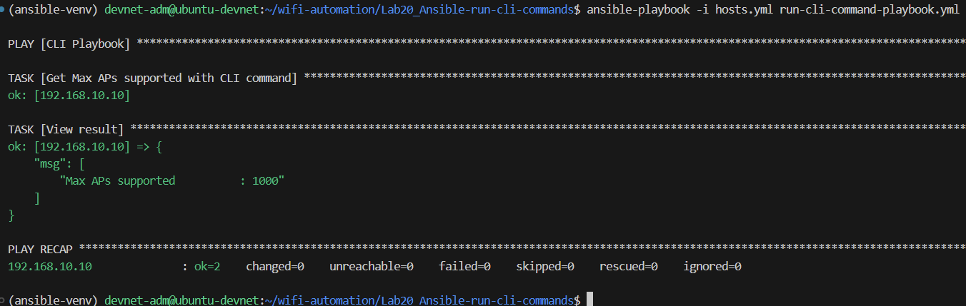
Run a CLI command - Example solution
Lab Exercise #20: Ansible - Run CLI commands
cli-playbook.yaml
---
- name: CLI Playbook
hosts: wlc
connection: network_cli
gather_facts: false
tasks:
- name: "Get Max APs supported with CLI command"
cisco.ios.ios_command:
commands: "show wireless summary | include Max APs"
register: result
- name: "View result"
ansible.builtin.debug:
msg: "{{ result.stdout }}"
Here is an example solution
The output should look like this

Slide 16
Ansible - CLI configuration - Intro
Lab Exercise #21: Ansible - CLI configuration
In this exercise, we will write a playbook that does some CLI configuration
A key concept of Ansible is "idempotency". That basically means
If something IT NOT configured, then go ahead and configure it
If something IS configured, just skip the task.
That means: DO NOT configure the same stuff again if it isn't necessary
This exercise will create a task that does this for a small part of the configuration. It can of course be expanded to a complete config. There are many ways to do this, some of which are
Putting everything in a gigantic playbook with hundreds of tasks (it might get heavy to navigate)
Splitting tasks for small config snippets in separate files, and call them all from a "master playbook"
Using Jinja2 templates (we will try this in a later exercise)
Using Ansible roles in combination with templates or tasks
... and many many more ;-)

Slide 17
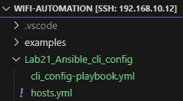
Ansible - CLI configuration - Tasks
Lab Exercise #21: Ansible - CLI configuration
Task 0: Set up the files and folders and VS Code
Create a working directory
Create a playbook file
Remember to activate the automation-venv
Task 1: Write a playbook that
Ensure that this policy profile is present on the WLC
Task 2: Run the playbook on your WLC
You can copy the inventory file hosts.yml from Day 1
Task 3: Verify the idempotency of the playbook. That means
If the config IS NOT present, it should be configured
If the config IS present, it should do nothing
devnet-adm@ubuntu-devnet:~/wifi-automation/Lab21_Ansible_cli_config$ source ~/automation-venv/bin/activate
(automation-venv) devnet-adm@ubuntu-devnet:~/wifi-automation/Lab21_Ansible_cli_config$ ansible --version
wireless profile policy clients_policy_profile
idle-timeout 3000
passive-client
session-timeout 43200
vlan 11
no shutdown
hosts.yml
wlc:
hosts:
192.168.10.{WLC-IP}:
vars:
ansible_connection: network_cli
ansible_network_os: ios
ansible_ssh_pass: restconf-pass
ansible_password: restconf-pass
ansible_user: restconf-adm
ansible_host_key_checking: False

Slide 18
Ansible - CLI configuration - Hints
Lab Exercise #21: Ansible - CLI configuration
Instead of this placeholder, you would use a module that can do CLI config on Cisco IOS devices. Try looking in the cisco.ios collection in the Ansible Docs https://docs.ansible.com/ansible/latest/collections/cisco/ios/index.html#plugins-in-cisco-ios
The module needs all the config lines that we want, as an ordered list, after a parameter specifying all those lines
The module also needs a parameter specifying which parent the config lines should belong to. The parent in this example is the policy profile. In another example it might be an interface, a WLAN, a site tag etc.
The structure of the file should be like this
cli_config-playbook.yml
---
- name: CLI Playbook
hosts: wlc
connection: network_cli
gather_facts: false
tasks:
- name: "Configure policy profile: clients_policy_profile"
some_module_that_will_do_ios_config:
some_parameter_with_config_lines:
- idle-timeout 3000
- passive-client
- session-timeout 43200
- vlan 11
- no shutdown
some_parent_parameter: wireless profile policy clients_policy_profile
Run the playbook with this command
(automation-venv) devnet-adm@ubuntu-devnet:~/wifi-automation/Lab21_Ansible_cli_config$ ansible-playbook -i hosts.yml cli-config-playbook.yml

Slide 19
Ansible - CLI configuration - Hints 2
Lab Exercise #21: Ansible - CLI configuration
If you try to change the VLAN ID from 11 to 12, you will notice that nothing changes on the WLC. That is because the policy profile needs to be shutdown before making changes if it already exists. You can test this on your WLC with the following commands
To address this, we can use the before: and after: statements in the task, to get Ansible to add certain commands before and after the lines that we compare. The before and after sections will only be run if the task itself would create a change (i.e. if the lines do not match)
wlc9# wlc9#conf t
wlc9(config)# wireless profile policy clients_policy_profile
wlc9(config-wireless-policy)# vlan 12
% Policy profile needs to be disabled before performing this operation.
These lines will be entered before the lines that we compare
Since we enter "no shutdown" after the lines themselves, we do not need this in the lines
These lines will be entered after the lines that we compare
(parts of) cli_config-playbook.yml
- name: "Configure policy profile: clients_policy_profile"
cisco.ios.ios_config:
before:
- wireless profile policy clients_policy_profile
- shutdown
lines:
- idle-timeout 3000
- passive-client
- session-timeout 43200
- vlan 11
after:
- no shutdown
some_parent_parameter: wireless profile policy clients_policy_profile

Slide 20
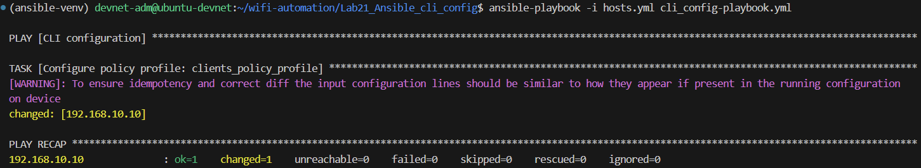
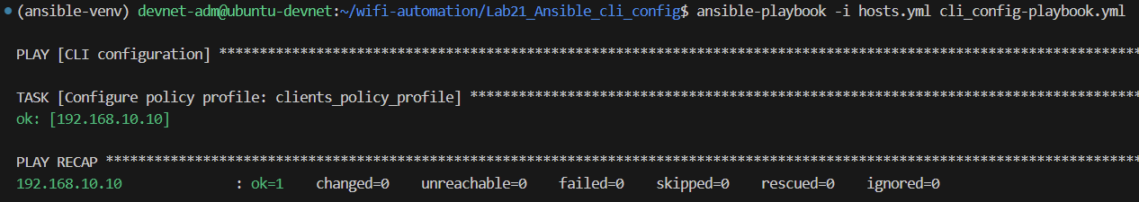
Ansible - CLI configuration - Example solution
Lab Exercise #21: Ansible - CLI configuration
cli-playbook.yaml
---
- name: CLI configuration
hosts: wlc
connection: network_cli
gather_facts: false
tasks:
- name: "Configure policy profile: clients_policy_profile"
cisco.ios.ios_config:
before:
- wireless profile policy clients_policy_profile
- shutdown
lines:
- idle-timeout 3000
- passive-client
- session-timeout 43200
- vlan 11
after:
- no shutdown
parents: wireless profile policy clients_policy_profile
Here is an example solution
First time run, output should be like this, and the policy profile appear on WLC
On next run, the config should already be present
wlc9800#show run | sec wireless profile policy
wireless profile policy lab-policy
no central authentication
no central dhcp
no central switching
dhcp-tlv-caching
http-tlv-caching
vlan 11
no shutdown
wireless profile policy clients_policy_profile
idle-timeout 3000
passive-client
session-timeout 43200
vlan 11
no shutdown
wireless profile policy default-policy-profile
description "default policy profile"

Slide 21
Ansible - CLI configuration - Extra tasks
Lab Exercise #21: Ansible - CLI configuration
Create some more tasks in the playbook, for configuring
Interfaces. You can play with Gig2 and Gig3, or create VLAN interfaces or Loopbacks
WLANs. PSKs might be tricky to get idempotent once they are encrypted.
Global commands, like ensure restonf is enabled
Remember, for idempotency the commands must be exactly as they will appear in the running config. So don't use abbreviations in the config lines (like "desc" for description, "ip add" for ip address, etc.
They will be run and work, but next time you run they will be configured again since the command to push is different from what is present on the device.
The before and after statemens will have to be changed accordingly. For tasks that do not need to be shutdown, you will probably not need the before and after sections

Slide 22
Using Jinja2 templates - Intro
Lab Exercise #22: Ansible - Using Jinja2 templates
Jinja2 is a templating language, widely used by developers to create text files that have placeholders, which can be filled inn with various values. One very common example is HTML
Jinja2 is a native part of Ansible and the YAML files there. So anytime you write something in double curly braces it is a Jinja2 variable that will be replaced by the content of the variable when you run the playbook
Instead of using Jinja2 inline, we can store templates as separate files, and then refer to those templates when running our playbook
In this exercise, we will modify the playbook from our CLI configuration exercise to use Jinja2 templates instead of spelling out the commands in the playbook itself
One advantage of using templates is to reuse a playbook for various templates
Another advantage is the possibility to loop in the template itself, for instance looping over all site tags

Slide 23
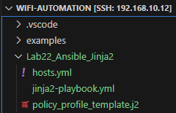
Using Jinja2 templates - Tasks
Lab Exercise #22: Ansible - Using Jinja2 templates
Task 0: Set up the files and folders and VS Code
Create a working directory
Create a playbook file
Remember to activate the automation-venv
Task 1: Write a playbook using a Jinja2 template
Ensure that this policy profile is present on the WLC
You can copy the inventory file hosts.yml from Day 1
Verify the idempotency (changes stuff only when needed)
Task 2: Change some of the text in the j2 template
Use a variable for the name and the VLAN ID
Use a loop statement in the task to do multiple policy profiles with the same template
devnet-adm@ubuntu-devnet:~/wifi-automation/Lab22_Ansible_Jinja2$ source ~/automation-venv/bin/activate
(automation-venv) devnet-adm@ubuntu-devnet:~/wifi-automation/Lab22_Ansible_Jinja2$ ansible --version
wireless profile policy clients_policy_profile_j2
session-timeout 43200
vlan 11
no shutdown
hosts.yml
wlc:
hosts:
192.168.10.{WLC-IP}:
vars:
ansible_connection: network_cli
ansible_network_os: ios
ansible_ssh_pass: restconf-pass
ansible_password: restconf-pass
ansible_user: restconf-adm
ansible_host_key_checking: False

Slide 24
Using Jinja2 templates - Hints for task 1
Lab Exercise #22: Ansible - Using Jinja2 templates
The structure of the file should be like this
jinja2-playbook.yml
This is where we put in the Jinja2 template file we created
---
- name: CLI Playbook
hosts: wlc
connection: network_cli
gather_facts: false
tasks:
- name: "Configure policy profile: clients_policy_profile_j2"
cisco.ios.ios_config:
before:
- wireless profile policy clients_policy_profile_j2
- shutdown
src: policy_profile_template.j2
match: line
after:
- no shutdown
Hint: It should contain the commands that you want in the config, as they appear in the config
Now, go ahead and fill inn the "policy_profile_template.j2" file
Run the playbook with this command
policy_profile_template.j2
wireless profile policy clients_policy_profile_j2
session-timeout 43200
vlan 11
no shutdown
(automation-venv) devnet-adm@ubuntu-devnet:~/wifi-automation/Lab22_Ansible_Jinja2$ ansible-playbook -i hosts.yml jinja2-playbook.yml

Slide 25
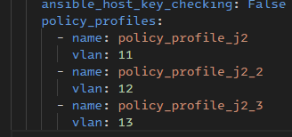
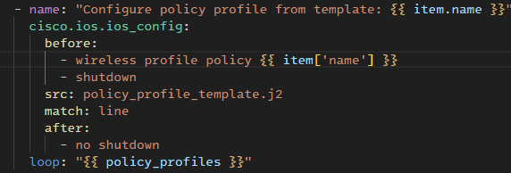
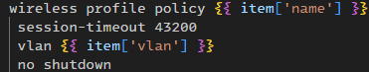
Using Jinja2 templates - Hints for task 2
Lab Exercise #22: Ansible - Using Jinja2 templates
Create some variables in the bottom of the hosts.yml file
Now we will try changing some of the static config in the template with some parameters
The parameters can come from different sources
hosts.yml (will be used in this exercise)
group_vars/ and host_vars/ directories
External systems using APIs (NetBox, Catalyst Center, etc)
Let us modify our files
hosts.yml
jinja2-playbook.yml
policy_profile_template.j2
Use the "loop" statement in the playbook, to loop over the policy_profiles list you created. - To reference the items that you loop over, you use keyword "item" - To reference sub-values, use dot notation or square bracket notation. Examples of both here, to reference the name and vlan of each item
Use the notation in the .j2 template as well

Slide 26
Using Jinja2 templates - Example solution
Lab Exercise #22: Ansible - Using Jinja2 templates
Change to YOUR WLC IP
jinja2-playbook.yml
hosts.yml
---
- name: CLI configuration using Jinja2 template
hosts: wlc
connection: network_cli
gather_facts: false
tasks:
- name: "Configure policy profile from template: {{ item.name }}"
cisco.ios.ios_config:
before:
- wireless profile policy {{ item['name'] }}
- shutdown
src: policy_profile_template.j2
match: line
after:
- no shutdown
loop: "{{ policy_profiles }}"
wlc:
hosts:
192.168.10.9:
vars:
ansible_connection: network_cli
ansible_network_os: ios
ansible_ssh_pass: ChangeMe2025!
ansible_password: ChangeMe2025!
ansible_user: devnet-adm
ansible_host_key_checking: False
policy_profiles:
- name: policy_profile_j2
vlan: 11
- name: policy_profile_j2_2
vlan: 12
- name: policy_profile_j2_3
vlan: 13
policy_profile_template.j2
wireless profile policy {{ item['name'] }}
session-timeout 43200
vlan {{ item['vlan'] }}
no shutdown
Optional tasks:
Can you change more parameters (ex. session-timeout value)?
Can you create templates for other stuff? Loopback interfaces (safe to play with), wlans, site tags, etc?

Slide 27
Ansible - Using RESTCONF - Intro
Lab Exercise #23: Ansible - Using RESTCONF
We can do RESTCONF calls directly from Ansible
Some pros with RESTCONF instead of CLI plugins from Ansible
The return can be JSON, which is easy to use like a dictionary
The speed of getting back data is high, especially if you compare to larger amount of CLI data. For instance, getting a table of connected clients when you have a lot of them
Some cons with RESTCONF instead of CLI plugins from Ansible
There must exist a YANG model for what you are looking for
You must find the correct xpath of the YANG model
In this exercise, we will get the certificates on the WLC, and more specifically the validity dates associated with the certs
We will use the YANG module "Cisco-IOS-XE-crypto-pki-oper" to get operational data about the certificates

Slide 28
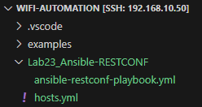
Ansible - Using RESTCONF - Tasks
Lab Exercise #23: Ansible - Using RESTCONF
Task 0: Set up the files and folders and VS Code
Create a working directory
Create a playbook file
Copy the hosts.yml from previous projects
Remember to activate the automation-venv
Task 1: Use YANG Suite (or yangcatalog.org) to find the RESTCONF path that will give details about the certificates
Load and view the details of the module "Cisco-IOS-XE-crypto-pki-oper"
Test the RESTCONF call towards your WLC with Postman
Add some filters, to only return the label, subject-name and validity-end
Task 2: Write the Ansible task to use your RESTCONF path
Use the "ansible.builtin.uri" module to perform the RESTCONF call
Print the results of the call
(optional task) Print the results of just the validity date of each result
devnet-adm@ubuntu-devnet:~/wifi-automation/Lab23_Ansible_RESTCONF$ source ~/automation-venv/bin/activate
(automation-venv) devnet-adm@ubuntu-devnet:~/wifi-automation/Lab23_Ansible_RESTCONF$ ansible --version

Slide 29
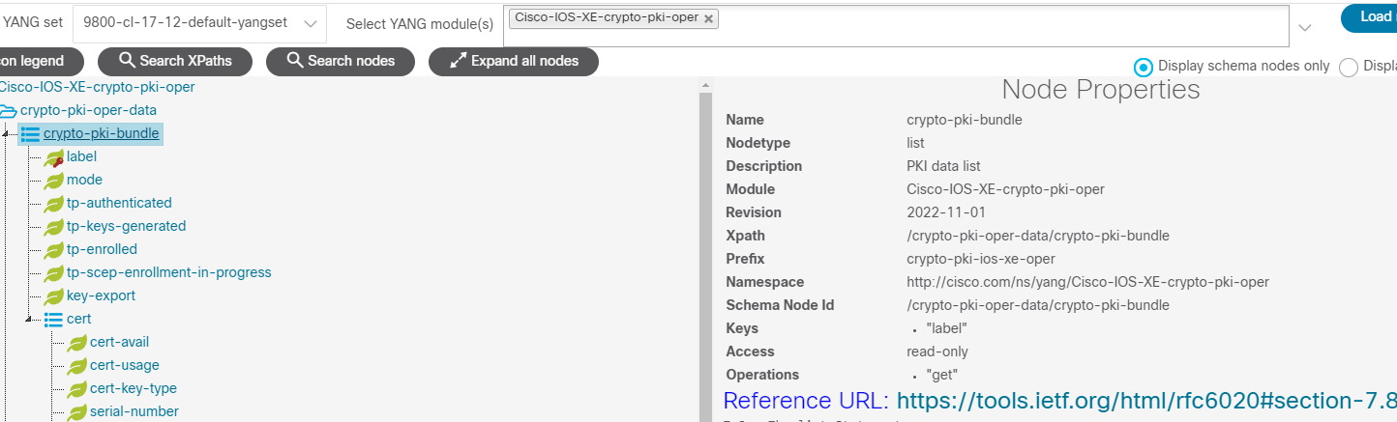
Ansible - Using RESTCONF - Hints for Task 1
Lab Exercise #23: Ansible - Using RESTCONF
Example on using YANG Suite to browse the "Cisco-IOS-XE-crypto-pki-oper" model
RESTCONF call for 9800: https://{WLC_IP}/restconf/data/{YANG module}:{xpath} WLC_IP: 192.168.10.9 (change to YOUR WLC IP) YANG module: Cisco-IOS-XE-crypto-pki-oper Xpath: crypto-pki-oper-data/crypto-pki-bundle
https://{{host}}/restconf/data/Cisco-IOS-XE-crypto-pki-oper:crypto-pki-oper-data/crypto-pki-bundle

Slide 30

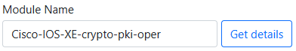


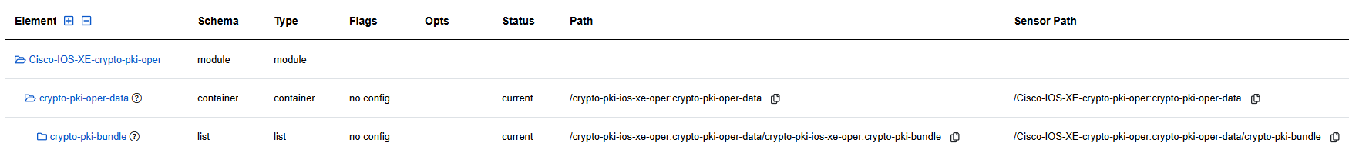
Ansible - Using RESTCONF - Hints for Task 1
Lab Exercise #23: Ansible - Using RESTCONF
Example on using yangcatalog.org to browse the "Cisco-IOS-XE-crypto-pki-oper" model
Use your browser to enter https://yangcatalog.org
Click "YANG Module Detail Viewer"
Start writing and then select the module. Click "Get details"
Click "Tree View"
Decide which level of data you want to retrieve. Let's start with the full bundle. You can click each line to expand or compact levels, or click the + next to "Element" to expand the full tree
On the right hand of the "crypto-pki-bundle" line you will find the path you need in the "Sensor Path" column
Copy the sensor path, and create the RESTCONF call:
https://{{host}}/restconf/data/Cisco-IOS-XE-crypto-pki-oper:crypto-pki-oper-data/crypto-pki-bundle

Slide 31
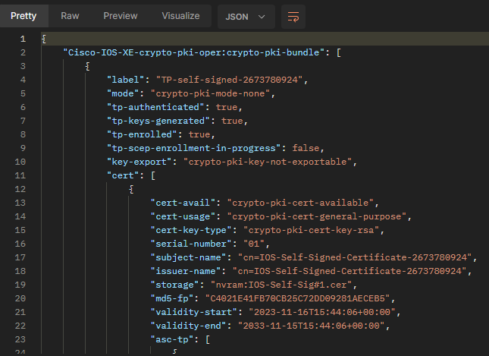


Ansible - Using RESTCONF - Hints for Task 1
Lab Exercise #23: Ansible - Using RESTCONF
Enter the path in Postman
You should hopefully get something like this, where you can see lots of details for each certificate on the device
To choose only a few fields, use the operator "?fields=" after the path. This example shows picking the label, subject-name and validity-end from above
https://{{host}}/restconf/data/Cisco-IOS-XE-crypto-pki-oper:crypto-pki-oper-data/crypto-pki-bundle?fields=label;cert/subject-name;cert/validity-end

Slide 32
Ansible - Using RESTCONF - Hints for Task 2
Lab Exercise #23: Ansible - Using RESTCONF
Here are some tips for writing the Ansible playbook
To perform the RESTCONF call, use the module "ansible.builtin.uri". Check the Ansible documentation for how-to and examples
"url" should be copy-paste of what you have tested in Postman, just replace {{host}} with {{ ansible_host}}
Try to replicate headers, body format and method from Postman
Do not validate certs
Specify some valid HTTP status codes, at least status code 200
Create a second task for printing the results. Start by printing all of the result.
Try to narrow down the printing (think, what can you do with the results beside printing to the screen. It might be out of scope for this lab, but very nice to test how you can manipulate the results). Tips, msg: {{result['json']}} is the first step
Use a when: statement on the print results part. It should only run when the status code is 200 "OK".

Slide 33
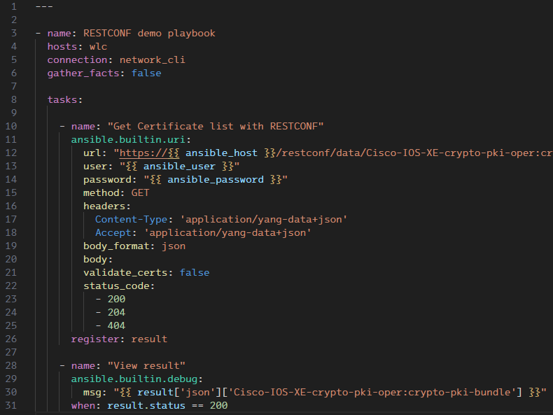
Ansible - Using RESTCONF - Example solution
Lab Exercise #23: Ansible - Using RESTCONF
ansible-restconf-playbook.yml
---
- name: RESTCONF demo playbook
hosts: wlc
connection: network_cli
gather_facts: false
tasks:
- name: "Get Certificate list with RESTCONF"
ansible.builtin.uri:
url: "https://{{ ansible_host }}/restconf/data/Cisco-IOS-XE-crypto-pki-oper:crypto-pki-oper-data/crypto-pki-bundle?fields=label;cert/subject-name;cert/validity-end"
user: "{{ ansible_user }}"
password: "{{ ansible_password }}"
method: GET
headers:
Content-Type: 'application/yang-data+json'
Accept: 'application/yang-data+json'
body_format: json
body:
validate_certs: false
status_code:
- 200
- 204
- 404
register: result
- name: "View result"
ansible.builtin.debug:
msg: "{{ result['json']['Cisco-IOS-XE-crypto-pki-oper:crypto-pki-bundle'] }}"
when: result.status == 200
Playbook and task header is similar to previous tasks
Using ansible.builtin.uri
URL copy-paste from what is tested in Postman
Change host, user and password with the ansible_host, ansible_user and ansible_password values
Try to replicate method, headers and body format from Postman
Do not validate the HTTPS certs (at least in this lab)
Valid return status codes
View the results using ansible.builtin.debug module
Only when the HTTP status code of the RESTCONF call is 200 ("OK")

Slide 34
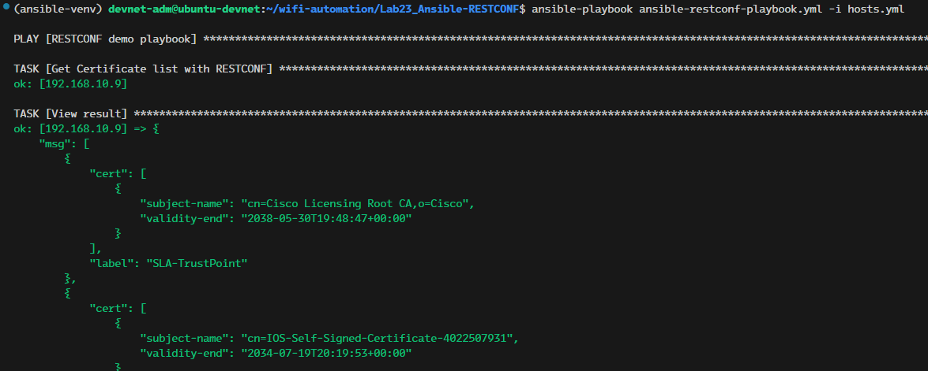
Ansible - Using RESTCONF - Example output
Lab Exercise #23: Ansible - Using RESTCONF
Example output

Slide 35
Ansible - Writing your own module - Intro
Lab Exercise #24: Ansible - Writing your own module using Python
If you want to do some stuff that is not supported in the builtin or community modules, you can write your own module. It can be small or large project, but it can also be something that is simple in Python, but that you would need to make complex structures in Ansible to solve
The example will
Get "show run" from our device(s) using the cisco.ios.ios_facts module
Call our own module that use the input and return values based on that
Print the result
This is a simple test/demo of a module. Some practical use of this module could be to check whether RESTCONF is enabled on a device, and based on the result of this test you could run other tasks as either RESTCONF, or fallback to CLI mode if RESTCONF is not available.

Slide 36
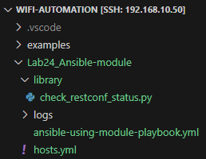
Ansible - Writing your own module - Tasks
Lab Exercise #24: Ansible - Writing your own module using Python
Task 0: Set up the files and folders and VS Code
Create a working directory and a playbook file "ansible-restconf-playbook.yml"
Copy the hosts.yml from previous projects
Create a "library" folder with a file "check_restconf_status.py" inside
Create a "logs" folder where we will dump some log files later
Remember to activate the automation-venv (use this for both Ansible and Python files in this exercise)
Task 1: Create the Python module
Use the example in the Ansible docs "Developing modules" as an example https://docs.ansible.com/ansible/latest/dev_guide/developing_modules_general.html
Task 2: Create the Ansible playbook
The playbook should have 3 tasks
Gather IOS facts (check docs on the cisco.ios.ios_facts module, https://docs.ansible.com/ansible/latest/collections/cisco/ios/ios_facts_module.html#ansible-collections-cisco-ios-ios-facts-module)
Run your module, it should be called the same way as a regular module, and the arguments indented below the module
Write the results to a YAML file
devnet-adm@ubuntu-devnet:~/wifi-automation/Lab24_Ansible-module$ source ~/automation-venv/bin/activate
(automation-venv) devnet-adm@ubuntu-devnet:~/wifi-automation/Lab24_Ansible-module$ ansible --version

Slide 37
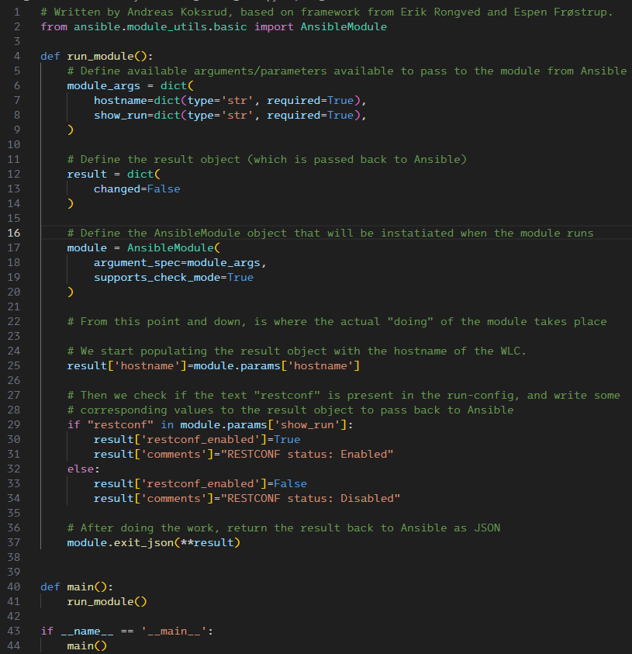
Ansible - Writing your own module - Hints for task 1
Lab Exercise #24: Ansible - Writing your own module using Python
I have removed all the docs from the example, you could probably keep it
module args should be "hostname" and "show_run", both dict objects of type 'str'
result should be dict, with changed=False and nothing else
In the part where the actual "doing" is taking place, put stuff into result dict. You can add new key-value-pairs as you like
Take the hostname from input parameters, put it in the result dict, under result['hostname']
Check if "restconf" is in the variable module.params['show_run']
If yes, put "True" in result['restconf_enabled']
If no, put "False" in result['restconf_enabled']
On exit, return the results back to Ansible

Slide 38
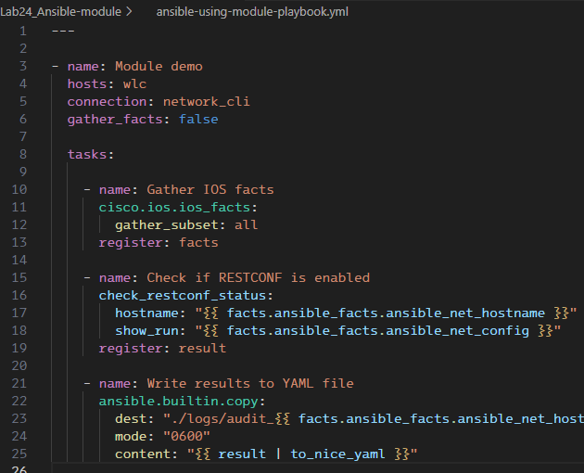
Ansible - Writing your own module - Hints for task 2
Lab Exercise #24: Ansible - Writing your own module using Python
Same playbook opening as we have used in the previous examples
Gather IOS facts from the devices
Call your module as you would any other module. As long as the name matches (without the .py extension) and it is located in the library folder, it will be found automatically
Indented under the module you put the input variables
Write the results to a YAML file
Try to finish the line yourself (or look at next page)
(optional) Try writing the results to JSON, it should be pretty similar, just format the content using "to_nice_json" instead

Slide 39
Ansible - Writing your own module - Example solution
Lab Exercise #24: Ansible - Writing your own module using Python
check_restconf_status.py
ansible-using-module-playbook.yml
# Written by Andreas Koksrud, based on framework from Erik Rongved and Espen Frøstrup.
from ansible.module_utils.basic import AnsibleModule
def run_module():
# Define available arguments/parameters available to pass to the module from Ansible
module_args = dict(
hostname=dict(type='str', required=True),
show_run=dict(type='str', required=True),
)
# Define the result object (which is passed back to Ansible)
result = dict(
changed=False
)
# Define the AnsibleModule object that will be instatiated when the module runs
module = AnsibleModule(
argument_spec=module_args,
supports_check_mode=True
)
# From this point and down, is where the actual "doing" of the module takes place
# We start populating the result object with the hostname of the WLC.
result['hostname']=module.params['hostname']
# Then we check if the text "restconf" is present in the run-config, and write some
# corresponding values to the result object to pass back to Ansible
if "restconf" in module.params['show_run']:
result['restconf_enabled']=True
result['comments']="RESTCONF status: Enabled"
else:
result['restconf_enabled']=False
result['comments']="RESTCONF status: Disabled"
# After doing the work, return the result back to Ansible as JSON
module.exit_json(**result)
def main():
run_module()
if __name__ == '__main__':
main()
---
- name: Module demo
hosts: wlc
connection: network_cli
gather_facts: false
tasks:
- name: Gather IOS facts
cisco.ios.ios_facts:
gather_subset: all
register: facts
- name: Check if RESTCONF is enabled
check_restconf_status:
hostname: "{{ facts.ansible_facts.ansible_net_hostname }}"
show_run: "{{ facts.ansible_facts.ansible_net_config }}"
register: result
- name: Write results to YAML file
ansible.builtin.copy:
dest: "./logs/audit_{{ facts.ansible_facts.ansible_net_hostname }} ({{ '%Y-%m-%d' | strftime }}).yml"
mode: "0600"
content: "{{ result | to_nice_yaml }}"
hosts.yml
wlc:
hosts:
192.168.10.9:
192.168.10.30:
vars:
ansible_connection: network_cli
ansible_network_os: ios
ansible_ssh_pass: ChangeMe2025!
ansible_password: ChangeMe2025!
ansible_user: devnet-adm
ansible_host_key_checking: False

Slide 40
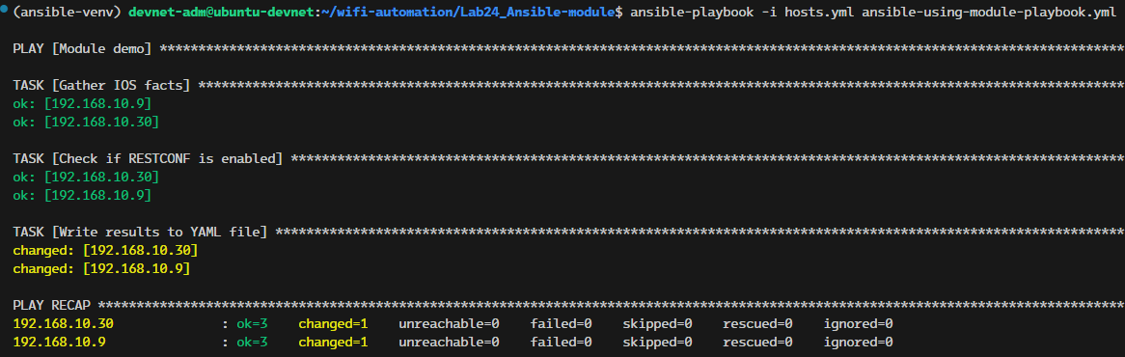
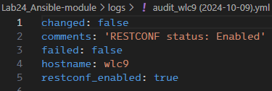
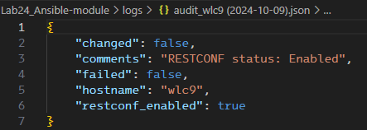
Ansible - Writing your own module - Example output
Lab Exercise #24: Ansible - Writing your own module using Python
Example output
Example of the written logfile (YAML) …. and the same, as JSON

Slide 41
Ansible – Using RESTCONF + Python-module - Intro
Lab Exercise #25: Ansible - Using RESTCONF + Python-module
This is another exercise where we create our own Python module to do some "magic" with output from Ansible, and return them back to Ansible after being processed
We will combine this with using RESTCONF directly from Ansible, as this is very fast compared to getting the same results using the command line
By "very fast" that refers to the run-time, but there will often be some more investigation to do first to get the correct YANG module path, compared to your well-known CLI command to do the same
The example will
Get all interfaces from the IOS-XE device using RESTCONF, including the descriptions
If the description of GigabitEthernet1 contains the word "Uplink" it will do nothing
If the description of GigabitEthernet1 does NOT contain the word "Uplink", it will create a new text for the description, with "Uplink" and a timestamp for the change
Push the updated interface config (description) back to the device using RESTCONF
Be aware that this example takes a lot of shortcuts, just to show the concept. Like being valid only for GigabitEthernet1's description. And no error checking (try to run it if you have no description at all on the Gig1 interface…)

Slide 42
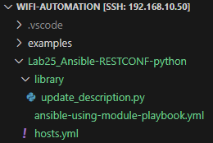
Ansible – Using RESTCONF + Python-module - Tasks
Lab Exercise #25: Ansible - Using RESTCONF + Python-module
Task 0: Set up the files and folders and VS Code
Create a working directory and a playbook file "ansible-using-module-playbook.yml"
Copy the hosts.yml from previous projects
Create a "library" folder with a file "update_description.py" inside
Remember to activate the automation-venv (use this for both Ansible and Python files in this exercise)
Task 1: Find the correct RESTCONF path
Use YANG Suite or yangcatalog.org, check the module Cisco-IOS-XE-native and the :native/interface path
Task 2: Create the Ansible playbook
Get interface list with RESTCONF (see Lab 23, but check out the YANG path Cisco-IOS-XE-native:native/interface instead)
Do something with the interface dictionary in a Python module (see Lab 24, but pass in restconf_result['json'] instead), return the interface dict to Ansible
Update the interface list/description using RESTCONF with the returned interface dict
3 "extra" tasks could be "view result" tasks between each of your main tasks, for easier debugging
Task 3: Create the Python module
Use the example in the Ansible docs "Developing modules", or the module from the previous lab as an example https://docs.ansible.com/ansible/latest/dev_guide/developing_modules_general.html
devnet-adm@ubuntu-devnet:~/wifi-automation/Lab25_Ansible-RESTCONF-python$ source ~/automation-venv/bin/activate
(automation-venv) devnet-adm@ubuntu-devnet:~/wifi-automation/Lab25_Ansible-RESTCONF-python$ ansible --version

Slide 43
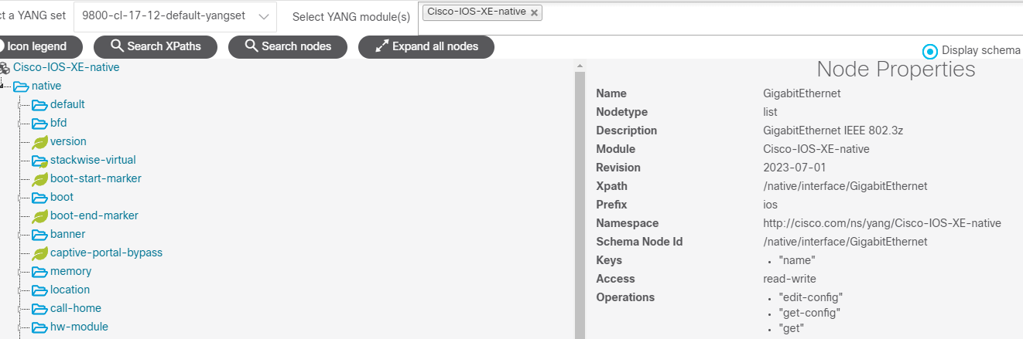
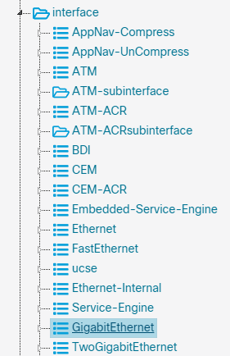
Ansible – Using RESTCONF + Python-module - Hints for Task 1
Lab Exercise #25: Ansible - Using RESTCONF + Python-module
Example on using YANG Suite to find the correct path

Slide 44
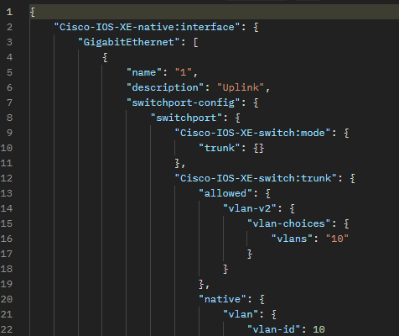
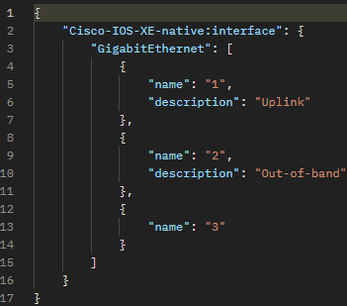
Ansible – Using RESTCONF + Python-module - Hints for Task 1
Lab Exercise #25: Ansible - Using RESTCONF + Python-module
Check in Postman:
Then we choose only a couple of fields, and try again

Slide 45
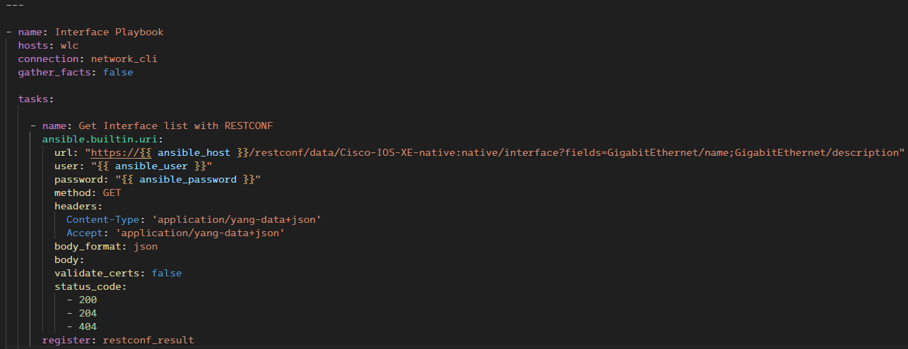
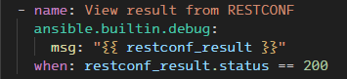
Ansible – Using RESTCONF + Python-module - Hints for Task 2
Lab Exercise #25: Ansible - Using RESTCONF + Python-module
We start by creating the task that gets the data from WLC, using the RESTCONF path we have tested in Postman
We create a simple "view" task, to easier understand and debug what we have got out. Only if the status code = 200.

Slide 46
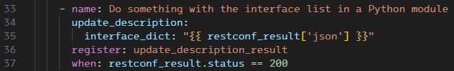

Ansible – Using RESTCONF + Python-module - Hints for Task 2
Lab Exercise #25: Ansible - Using RESTCONF + Python-module
Then we create a task that will send the interface dictionary (in JSON format) to our Python module for processing
We only do this if (when: ) the status code from our RESTCONF call equals 200 ("OK")
Again, we create a simple "view" task to view the results/output of the Python module processing, which we have registered in the variable "update_description_result"
And again, only if the result of the original RESTCONF call was "200 OK"

Slide 47
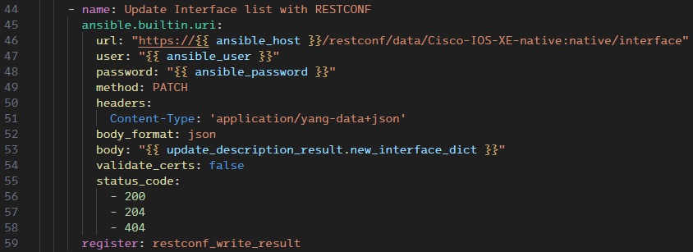
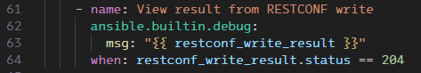
Ansible – Using RESTCONF + Python-module - Hints for Task 2
Lab Exercise #25: Ansible - Using RESTCONF + Python-module
The last part of the playbook, you might want to write after or in parallel with writing the Python module as it includes using the output from the module
We create the final of our three primary tasks for this playbook, updating the WLC interface description using RESTCONF
Notice that the use of the uri module is similar to the read task, only using PATCH instead of GET, and actually having some data in the "body" field. What we put in there is based on what we got out, only modified in the Python module which we will look into next
As usual, we have a "view" task to check the output

Slide 48
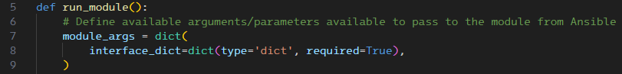
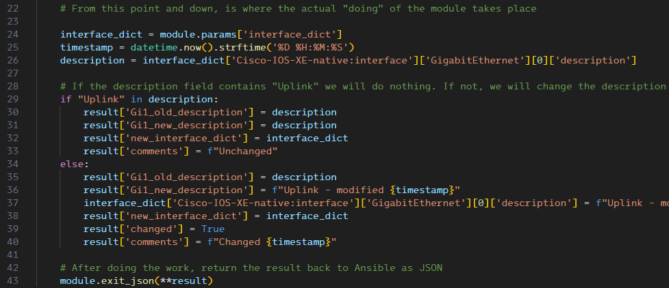
Ansible – Using RESTCONF + Python-module - Hints for Task 3
Lab Exercise #25: Ansible - Using RESTCONF + Python-module
Now we are ready to write the Python module "update_description.py". Lots of it will be identical to the previous Lab, but we have only one input parameter now. This will be the dictionary with the output from the RESTCONF call.
Then we do the actual reading and manipulation of the input
Put the input dictionary in a variable
Extract the description text. An intermediate step here could be to do a print() of the interface_dict
Check if the text "Uplink" is in the description. If it is, we do nothing
If there is no "Uplink" text in the description, we create a new description text, including a timestamp
Then, we put the updated interface dictionary into the "result" dictionary, so Ansible can use it. Note here, that we put it under the key ['new_interface_dict'] which is where we extract it from in the Ansible playbook (line 53)

Slide 49
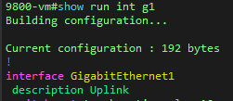
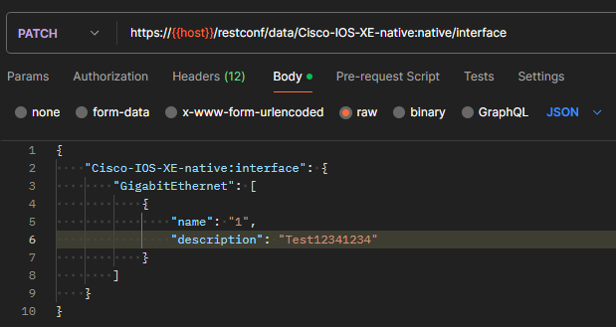
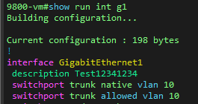

Ansible – Using RESTCONF + Python-module - Hints for Task 3
Lab Exercise #25: Ansible - Using RESTCONF + Python-module
You can test the writing part in Postman
Change "GET" to "PATCH"
Put the modified body field in the "body" section

Slide 50
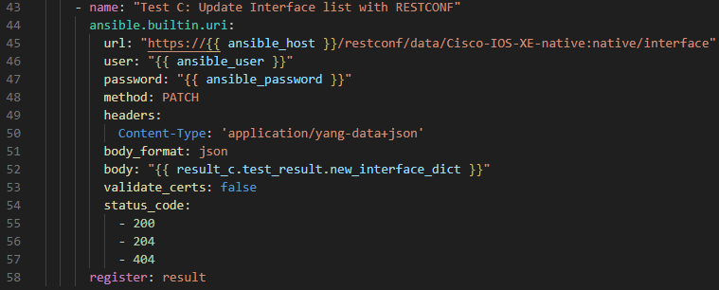
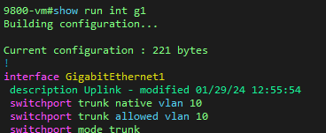
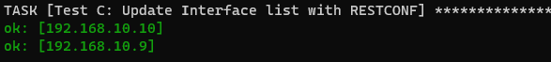
Ansible – Using RESTCONF + Python-module - Hints for Task 3
Lab Exercise #25: Ansible - Using RESTCONF + Python-module
This is the same part we tested in Postman, only in Ansible
Using the variable that was updated with the Python module

Slide 51
Ansible – Using RESTCONF + Python-module - Example solution
Lab Exercise #25: Ansible - Using RESTCONF + Python-module
interface-playbook.yaml
update_description.py
WLC before changes
---
- name: Interface Playbook
hosts: wlc
connection: network_cli
gather_facts: false
tasks:
- name: Get Interface list with RESTCONF
ansible.builtin.uri:
url: "https://{{ ansible_host }}/restconf/data/Cisco-IOS-XE-native:native/interface?fields=GigabitEthernet/name;GigabitEthernet/description"
user: "{{ ansible_user }}"
password: "{{ ansible_password }}"
method: GET
headers:
Content-Type: 'application/yang-data+json'
Accept: 'application/yang-data+json'
body_format: json
body:
validate_certs: false
status_code:
- 200
- 204
- 404
register: restconf_result
- name: Do something with the interface list in a Python module
update_description:
interface_dict: "{{ restconf_result['json'] }}"
register: update_description_result
when: restconf_result.status == 200
- name: View result
ansible.builtin.debug:
msg: "{{ update_description_result }}"
when: restconf_result.status == 200
- name: Update Interface list with RESTCONF
ansible.builtin.uri:
url: "https://{{ ansible_host }}/restconf/data/Cisco-IOS-XE-native:native/interface"
user: "{{ ansible_user }}"
password: "{{ ansible_password }}"
method: PATCH
headers:
Content-Type: 'application/yang-data+json'
body_format: json
body: "{{ update_description_result.new_interface_dict }}"
validate_certs: false
status_code:
- 200
- 204
- 404
register: restconf_write_result
- name: View result from RESTCONF write
ansible.builtin.debug:
msg: "{{ restconf_write_result }}"
when: restconf_write_result.status == 204
# Written by Andreas Koksrud, based on framework from Erik Rongved and Espen Frøstrup.
from ansible.module_utils.basic import AnsibleModule
from datetime import datetime
def run_module():
# Define available arguments/parameters available to pass to the module from Ansible
module_args = dict(
interface_dict=dict(type='dict', required=True),
)
# Define the result object (which is passed back to Ansible)
result = dict(
changed=False
)
# Define the AnsibleModule object that will be instatiated when the module runs
module = AnsibleModule(
argument_spec=module_args,
supports_check_mode=True
)
# From this point and down, is where the actual "doing" of the module takes place
interface_dict = module.params['interface_dict']
timestamp = datetime.now().strftime('%D %H:%M:%S')
description = interface_dict['Cisco-IOS-XE-native:interface']['GigabitEthernet'][0]['description']
# If the description field contains "Uplink" we will do nothing. If not, we will change the description including a timestamp just for fun
if "Uplink" in description:
result['Gi1_old_description'] = description
result['Gi1_new_description'] = description
result['new_interface_dict'] = interface_dict
result['comments'] = f"Unchanged"
else:
result['Gi1_old_description'] = description
result['Gi1_new_description'] = f"Uplink - modified {timestamp}"
interface_dict['Cisco-IOS-XE-native:interface']['GigabitEthernet'][0]['description'] = f"Uplink - modified {timestamp}"
result['new_interface_dict'] = interface_dict
result['changed'] = True
result['comments'] = f"Changed {timestamp}"
# After doing the work, return the result back to Ansible as JSON
module.exit_json(**result)
def main():
run_module()
if __name__ == '__main__':
main()
wlc9#show run int g1
Building configuration...
Current configuration : 164 bytes
!
interface GigabitEthernet1
description Test123
switchport trunk native vlan 10
switchport trunk allowed vlan 10,11
switchport mode trunk
negotiation auto
end
WLC after changes
wlc9#show run int g1
Building configuration...
Current configuration : 194 bytes
!
interface GigabitEthernet1
description Uplink - modified 10/15/24 20:25:40
switchport trunk native vlan 10
switchport trunk allowed vlan 10,11
switchport mode trunk
negotiation auto
end
hosts.yml
wlc:
hosts:
192.168.10.9:
192.168.10.30:
vars:
ansible_connection: network_cli
ansible_network_os: ios
ansible_ssh_pass: ChangeMe2025!
ansible_password: ChangeMe2025!
ansible_user: devnet-adm
ansible_host_key_checking: False

Slide 52
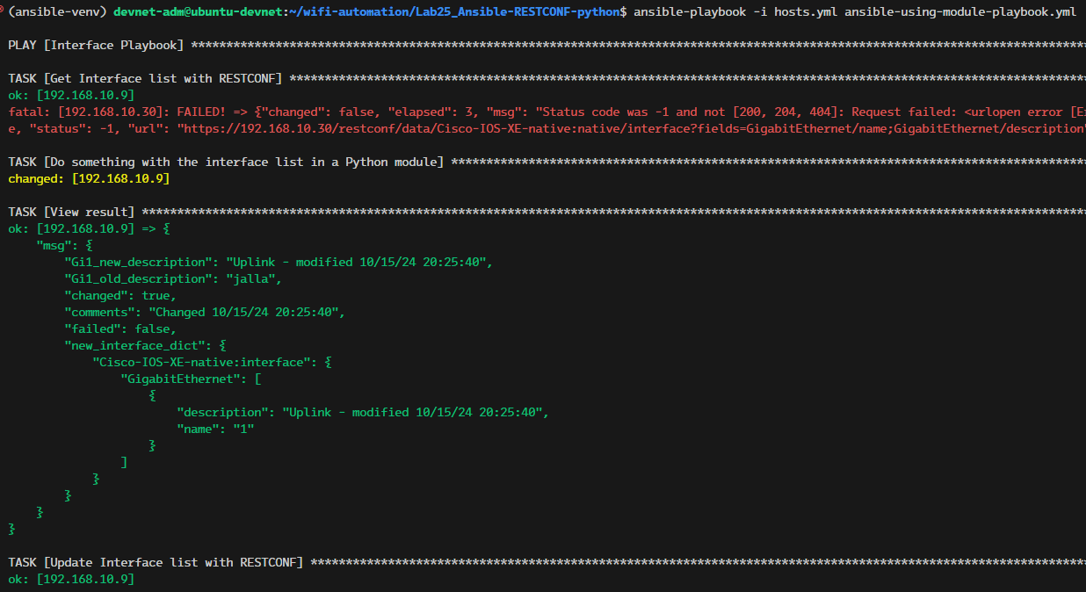
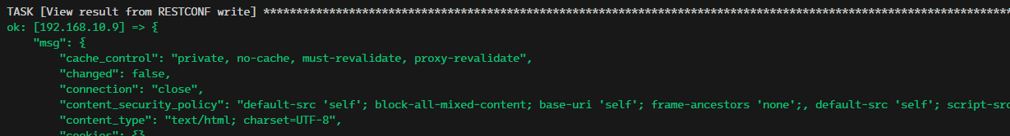
Ansible – Using RESTCONF + Python-module - Example output
Lab Exercise #25: Ansible - Using RESTCONF + Python-module
One of the WLCs were not available
The Python module did something to the input. Since we put result['changed']=True, it will report that the task did change something
View result from the Python module, here we can see the full "result", including the new interface dict which we use in the RESTCONF task to write to the WLC next
Here we have written to WLC using RESTCONF
And print the write result

Slide 53
Organizing projects using import_playbook - Intro
Lab Exercise #26: Ansible - Organizing projects using import_playbook
For larger projects, there are several ways to organize stuff
I like to break projects down into as small parts as possible
Each part will be easy to both maintain and understand
Code will be easier to reuse, change and troubleshoot
A playbook can run other playbooks by using the import_playbook module, which we will do in this exercise
A playbook can also call tasks by using the roles module, which is what we will do in the next exercise
General best practices (for Ansible and everything else…)
Try to keep each part as simple as possible
Use whitespace and comments to break things up and explain generously. What is obvious to you will probably not be obvious to everyone
In the following task we will create a (somewhat constructed) example using some of these techniques
Reference: https://docs.ansible.com/ansible/latest/tips_tricks/sample_setup.html#sample-directory-layout

Slide 54
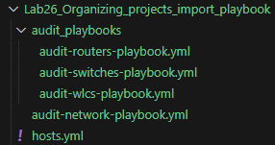
Organizing projects using import_playbook - Tasks
Lab Exercise #26: Ansible - Organizing projects using import_playbook
Task 0: Set up the files and folders and VS Code
Create directories according to this example
Create playbook files according to this example
Task 1: Create an extended variant of our hosts.yml file
The inventory should include
Shared switch (192.168.10.2)
Your WLC (192.168.10.{YOUR_WLC_IP})
Shared WLC (192.168.10.9)
Task 2: Create the three playbooks in the "audit_playbooks" folder
They should be simple playbooks, use what you have learned. The example use two tasks:
Gather IOS facts (using cisco.ios.ios_facts module)
Output hostname and version (using ansible.builtin.debug module and prints text from the facts)
Task 3: Create the audit-network-playbook.yml playbook which is used to run the other three playbooks using the ansible.builtin.import_playbook module

Slide 55
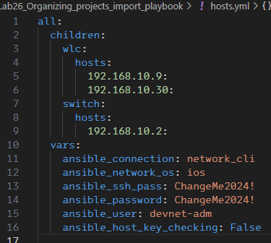
Organizing projects using import_playbook - Hints for Task 1
Lab Exercise #26: Ansible - Organizing projects using import_playbook
To accommodate for more than only WLCs, we create a slightly more advanced structure for our inventory file than we have done until now
Top-level group is "all"
Under "all" we have "children"
Under the children we have "wlc" and "switch"
The "vars" are common for all devices, so we have it directly under the "all" group, on the same level as "children"
It is also possible to have "vars" under each child group (on the same level as "hosts"). This is not used here.
It is also possible to have vars under each host. This is not used here.

Slide 56
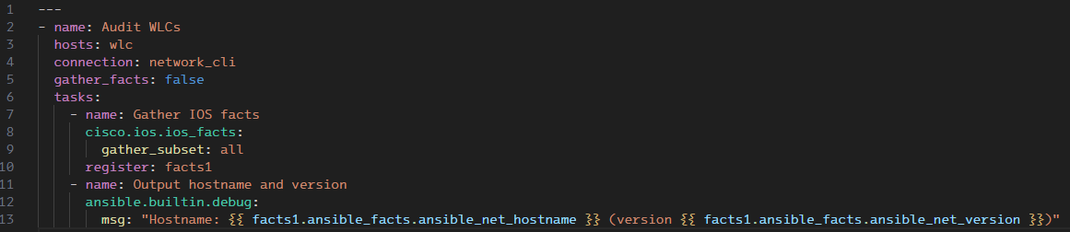
Organizing projects using import_playbook - Hints for Task 2
Lab Exercise #26: Ansible - Organizing projects using import_playbook
This is the "audit-wlcs-playbook.yml". The others in the example will be identical except the task name
For real-world the tasks for each device type would probably differ, else they don't need to be separate ☺
We start with the usual playbook opening we have used in the previous tasks
Then we have a "Gather IOS facts" task using the "cisco.ios.ios_facts" module: Register the result in a variable for later use
Lastly we have a output task, using "ansible.builtin.debug" module to output parts of the registered results.
Notice we use Jinja2 here. To see the full contents of "facts1" you could run this using only msg: {{ facts1 }} to see what is contained within the results. Then expand to msg: {{ facts1.ansible_facts }} before using the single values in your text
Copy-paste this playbook to similar variants for router and switch (change hosts: wlc to hosts: switch and hosts: router)

Slide 57
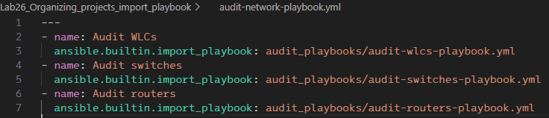
Organizing projects using import_playbook - Hints for Task 3
Lab Exercise #26: Ansible - Organizing projects using import_playbook
In the main playbook "audit-network-playbook.yml" we have 3 tasks with only one line in each. They simply run the other playbooks (from the subfolder)

Slide 58
Organizing projects using import_playbook - Example solution
Lab Exercise #26: Ansible - Organizing projects using import_playbook
audit-network-playbook.yml
audit-routers-playbook.yml
---
- name: Audit WLCs
ansible.builtin.import_playbook: audit_playbooks/audit-wlcs-playbook.yml
- name: Audit switches
ansible.builtin.import_playbook: audit_playbooks/audit-switches-playbook.yml
- name: Audit routers
ansible.builtin.import_playbook: audit_playbooks/audit-routers-playbook.yml
---
- name: Audit routers
hosts: router
connection: network_cli
gather_facts: false
tasks:
- name: Gather IOS facts
cisco.ios.ios_facts:
gather_subset: all
register: facts1
- name: Output hostname and version
ansible.builtin.debug:
msg: "Hostname: {{ facts1.ansible_facts.ansible_net_hostname }} (version {{ facts1.ansible_facts.ansible_net_version }})"
hosts.yml
all:
children:
wlc:
hosts:
192.168.10.9:
192.168.10.30:
switch:
hosts:
192.168.10.2:
vars:
ansible_connection: network_cli
ansible_network_os: ios
ansible_ssh_pass: ChangeMe2025!
ansible_password: ChangeMe2025!
ansible_user: devnet-adm
ansible_host_key_checking: False
audit-switches-playbook.yml
---
- name: Audit switches
hosts: switch
connection: network_cli
gather_facts: false
tasks:
- name: Gather IOS facts
cisco.ios.ios_facts:
gather_subset: all
register: facts1
- name: Output hostname and version
ansible.builtin.debug:
msg: "Hostname: {{ facts1.ansible_facts.ansible_net_hostname }} (version {{ facts1.ansible_facts.ansible_net_version }})"
audit-wlcs-playbook.yml
---
- name: Audit WLCs
hosts: wlc
connection: network_cli
gather_facts: false
tasks:
- name: Gather IOS facts
cisco.ios.ios_facts:
gather_subset: all
register: facts1
- name: Output hostname and version
ansible.builtin.debug:
msg: "Hostname: {{ facts1.ansible_facts.ansible_net_hostname }} (version {{ facts1.ansible_facts.ansible_net_version }})"

Slide 59

Organizing projects using import_playbook - Example output
Lab Exercise #26: Ansible - Organizing projects using import_playbook
Since we do not have a "router" group in our hosts.yml file, we get a warning when we run the playbook since it does not match any host groups

Slide 60
Organizing projects using Roles - Intro
Lab Exercise #27: Ansible - Organizing projects using Roles
Instead of using a master playbook to run other playbooks, in this exercise we will use "roles" to call tasks on each device that has that role
The example will still be somewhat constructed and simplified to primarily show the concept of roles rather than being super-useful in the real world by itself
This example contains two roles
get_version: This role gets and prints the current version of the device, and is applied to all our devices (reuse some of the playbook from Lab 5)
get_max_aps: This gets the maximum number of APs on a WLC, it is applied only to the WLC (reuse playbook from Lab 20)
Reference: https://docs.ansible.com/ansible/latest/network/getting_started/network_roles.html

Slide 61

Organizing projects using Roles - Tasks
Lab Exercise #27: Ansible - Organizing projects using Roles
Task 0: Set up the files and folders and VS Code
Create directory get_max_aps and subdirectory tasks, wherein you create main.yml
Create directory get_version and subdirectory tasks, wherein you create main.yml
Create the audit-network-playbook.yml
Copy the hosts.yml file from the previous exercise
Task 1: Create the audit-network-playbook.yml content
Playbook task 1: Get version from all Cisco devices, for "all" hosts, using the roles "get_version"
Playbook task 2: Get max APs from WLCs, for "wlc" hosts, using the roles "get_max_aps"
Task 2: Create the role get_version
Edit the main.yml in the get_version/tasks folder. It should have two tasks:
Gather IOS facts. Reuse from Lab 5, but only the task, not the playbook stuff before the task. You will need to de-indent this to avoid indentation errors since you drop the "outer layer" in the yaml file
Ouput task, use the ansible.builtin.debug module instead of writing to file as you did in Lab 5. You can narrow down the output to only ansible_net_hostname and ansible_net_version with some enclosing text
Task 3: Create role get_max_aps
Edit the main.yml in the get_max_aps/tasks folder. It should have two tasks:
Gather Max APs supported. Reuse from Lab 20, but only the task, not the playbook stuff before the task. You will need to de-indent this to avoid indentation errors since you drop the "outer layer" in the yaml file
Ouput task, use the ansible.builtin.debug module, you can print the {{ result.stdout }} message

Slide 62

Organizing projects using Roles - Hints for Task 1
Lab Exercise #27: Ansible - Organizing projects using Roles
We start with creating the audit-network-playbook.yml content
It consists of two tasks, as you can see there is not any explicit "doing" in these tasks, they just have some roles assigned
To expand this example, you could have more roles under the relevant tasks for the different device groups. For instance, the roles under the first task could also include roles "get_restconf_status", "backup_run_config" etc. The WLC specific task could have roles for "get_ap_summary", "get_wireless_clients" etc
Our reusable roles are entered under the "roles" section in each task

Slide 63

Organizing projects using Roles - Hints for Task 2
Lab Exercise #27: Ansible - Organizing projects using Roles
To "create" the role get_version we have created the subfolder "get_version" with another subfolder "tasks", in where there is a file named "main.yml". This structure is identical for all roles, just change the upper folder name
As you can see from the example below, the role itself does just contain the same tasks that we create in Lab5, except that we output the results to the terminal using debug, instead of writing to a file

Slide 64

Organizing projects using Roles - Hints for Task 3
Lab Exercise #27: Ansible - Organizing projects using Roles
The "get_max_aps" role is created in the same way as the previous role. You just have to have the folder named after your role, create a "tasks" folder inside that, and the "main.yml" file in the tasks folder
The tasks in the role main.yml are copy-paste from Lab20, just remember to de-indent them one level, since they are on their own and not under a "tasks:" statement

Slide 65

Organizing projects using Roles - Example solution
Lab Exercise #27: Ansible - Organizing projects using Roles
audit-network-playbook.yml
get_max_aps/tasks/main.yml
---
- name: Get version from all Cisco devices
hosts: all
connection: network_cli
gather_facts: false
roles:
- get_version
- name: Get max APs
hosts: wlc
connection: network_cli
gather_facts: false
roles:
- get_max_aps
---
- name: "Get Max APs supported with CLI command"
cisco.ios.ios_command:
commands: "show wireless summary | include Max APs"
register: result
- name: "View result"
ansible.builtin.debug:
msg: "{{ result.stdout }}"
get_version/tasks/main.yml
---
- name: Gather IOS facts
cisco.ios.ios_facts:
gather_subset: all
register: facts1
- name: Output hostname and version
ansible.builtin.debug:
msg: "Hostname: {{ facts1.ansible_facts.ansible_net_hostname }} (version {{ facts1.ansible_facts.ansible_net_version }})"
hosts.yml
all:
children:
wlc:
hosts:
192.168.10.9:
192.168.10.30:
switch:
hosts:
192.168.10.2:
vars:
ansible_connection: network_cli
ansible_network_os: ios
ansible_ssh_pass: ChangeMe2025!
ansible_password: ChangeMe2025!
ansible_user: devnet-adm
ansible_host_key_checking: False

Slide 66

Organizing projects using Roles - Example output
Lab Exercise #27: Ansible - Organizing projects using Roles

Slide 67


Next steps suggestions
In-depth: Ansible - Next steps
A possible next step after doing these labs, would be to look into AWX
Web based GUI, great for organizing and orchestrating
Task engine for scheduling playbooks etc
Using NetBox for inventory management and single source of truth
Ansible playbooks can run based on an inventory in NetBox
Ansible playbooks can populate fields in NetBox
Fields (standard or custom) in NetBox can decide stuff in Ansible
E.g.: is it a WLC? -> Run this task
Any ideas for new exercises to add to this deep dive? What would you like to see in the next version?

Slide 68
In-depth: Python
In-depth: Python
This part of the Day 2 labs will focus on using Python
Python for automation can be used directly, or as a building block in other tools/solutions
!!! As you progress through the script and tasks, you will come across missing packages !!!
Install them in your VENV (automation-venv) with the following command (netmiko used as example)
If you are not in your venv, you enter using this command. It will be repeated in the Task 0 of each exercise.
You will see which venv you are in by the (automation-venv) at the beginning of each line
To "get out" of your venv, you can run the "deactivate" command, or restart the terminal/SSH
(automation-venv) devnet-adm@ubuntu-devnet:~/wifi-automation/ Lab40_Python_Netmiko$ pip install netmiko
devnet-adm@ubuntu-devnet:~/wifi-automation/Lab40_Python_Netmiko$ source ~/automation-venv/bin/activate
(automation-venv) devnet-adm@ubuntu-devnet:~/wifi-automation/ Lab40_Python_Netmiko$
(automation-venv) devnet-adm@ubuntu-devnet:~/wifi-automation/ Lab40_Python_Netmiko$ deactivate
devnet-adm@ubuntu-devnet:~/wifi-automation/Lab40_Python_Netmiko$

Slide 69
Python - Using Netmiko - Intro
Lab Exercise #40: Python - Netmiko
In this exercise, we will write a python script that connects to the WLC using SSH
The script will
Take the WLC IP as input
Do a user/pass prompt before connecting
Have a menu with these choices
Show AP summary
Show client summary
Show CDP neighbors
Save run-config to a timestamped file
You can extend the script as you like, be creative
There is not much error checking, you can put in stuff like checking if it is really a WLC, etc
Reference: https://github.com/ktbyers/netmiko/blob/develop/README.md

Slide 70


Python - Using Netmiko - Tasks
Lab Exercise #40: Python - Netmiko
Task 0: Set up the files and folders and VS Code
Create a working directory
Create a Python file called "netmiko-script.py"
Activate the automation-venv
Task 1: Write a python script that
Take the WLC IP as input
Prints the WLC IP with some text as output, then quits
Task 2: Extend the script, so it will
Ask for username and password
Connect to the IP using the username and password
Do a show command (show ip interfaces brief or something), then quits
(optional) Task 3: Extend the script, so it will
Present a menu with the 4 choices from previous slide
Run the commands, then quit
devnet-adm@ubuntu-devnet:~/wifi-automation/Lab40_Python_Netmiko$ source ~/automation-venv/bin/activate
(automation-venv) devnet-adm@ubuntu-devnet:~/wifi-automation/ Lab40_Python_Netmiko$ python --version

Slide 71



Python - Using Netmiko - Hints: Task 1
Lab Exercise #40: Python - Netmiko
Start with the print command, printing a static text
Then add the input, which is saved to a variable "wlc_ip"
Notice the "f-string" formatting of the printed text. This is widely used in Python to use variables inside strings.
To keep this short and simple, we have no error checking. So the "IP" you enter could just as well be "blablabla"
This will be the case in most of these labs, it is by design
Depending on the usage of your script, you should probably add some error checking, especially if used by others. One example would be to use regex to check if the value is a correct IP address, so the output could be like this
40_Python_Netmiko$ python netmiko-script.py
WLC IP:
40_Python_Netmiko$ python netmiko-script.py
Enter WLC IP: 1.2.3.4
The WLC IP is: 1.2.3.4
40_Python_Netmiko$ python netmiko-script.py
Enter WLC IP: blablabla
The WLC IP is: blablabla
40_Python_Netmiko$ python netmiko-script.py
Enter WLC IP: blablabla
Invalid IP address, exiting...

Slide 72




Python - Using Netmiko - Hints: Task 2
Lab Exercise #40: Python - Netmiko
Building on the work from Task 1, we add user/pass input
Now, we will make Netmiko connect and run a command
import the ConnectHandler function from Netmiko
Create a "cisco_wlc" dictionary which ConnectHandler use as input
Create a "command" variable, which we print, and send to the WLC
Example output from running the script so far
40_Python_Netmiko$ python netmiko-script.py
Enter WLC IP: 192.168.10.9
Username: devnet-adm
Password:
Command: show ip int brief
Interface IP-Address OK? Method
GigabitEthernet1 unassigned YES unset
GigabitEthernet2 unassigned YES unset
GigabitEthernet3 unassigned YES unset
Vlan1 unassigned YES NVRAM
Vlan10 192.168.10.10 YES NVRAM

Slide 73



Python - Using Netmiko - Hints: Task 3
Lab Exercise #40: Python - Netmiko
To accomplish this you should separate the tasks into functions
You write a function this way
To use the function, use the function name
An example structure for Task3 can be:
imports (same as Task2)
Define functions for each menu choice (hints on next page)
Setup netmiko
Create a while loop with a menu

Slide 74

Python - Using Netmiko - Hints: Task 3
Lab Exercise #40: Python - Netmiko
Example of functions

Slide 75
Python - Using Netmiko - Example solution
Lab Exercise #40: Python - Netmiko
netmiko-script.py
import getpass
import datetime
from netmiko import ConnectHandler
wlc_ip = input('WLC IP: ')
username = input('Username: ')
password = getpass.getpass('Password: ')
# Use netmiko to connect to the WLC
cisco_wlc = {
'device_type': 'cisco_ios',
'ip': wlc_ip,
'username': username,
'password': password
}
net_connect = ConnectHandler(**cisco_wlc)
# Define functions
def show_ap_summary():
print(net_connect.send_command("show ap summary"))
def show_client_summary():
print(net_connect.send_command("show wireless client summary"))
def show_cdp_neighbors():
print("WLC CDP neighbors:\n-------------------------------------")
print(net_connect.send_command("show cdp neighbors"))
print("AP CDP neighbors:\n-------------------------------------")
print(net_connect.send_command("show ap cdp neighbors"))
def save_config_to_file():
output=net_connect.send_command("show run")
now = datetime.datetime.now()
filename = f"{wlc_ip}-run-conf ({now.strftime('%Y-%m-%d %H:%M:%S')}).txt"
with open(filename, 'w') as f:
f.write(output)
print(f"Config saved to {filename}")
# Text menu with 4 options that run each of the functions, or quit
while True:
print("\nText Menu:")
print("1. Show AP summary")
print("2. Show client summary")
print("3. Show CDP neighbors")
print("4. Save run-config to file")
print("5. Quit")
choice = input("Enter choice: ")
if choice == "1":
show_ap_summary()
elif choice == "2":
show_client_summary()
elif choice == "3":
show_cdp_neighbors()
elif choice == "4":
save_config_to_file()
elif choice == "5":
net_connect.disconnect()
break
else:
print("Invalid choice. Please choose again.")
Here is an example solution
Runtime output should be like this
(automation-venv) devnet-adm@ubuntu-devnet:~/wifi-automation/Lab40_Python_Netmiko$0_Python_Netmiko$ python netmiko-script.py
WLC IP: 192.168.10.9
Username: devnet-adm
Password:
Text Menu:
1. Show AP summary
2. Show client summary
3. Show CDP neighbors
4. Save run-config to file
5. Quit
Enter choice: 4
Config saved to 192.168.10.9-run-conf (2024-09-10 19:44:50).txt
Text Menu:
1. Show AP summary
2. Show client summary
3. Show CDP neighbors
4. Save run-config to file
5. Quit
Enter choice:

Slide 76
Get client table using RESTCONF - Intro
Lab Exercise #41: Python - Get clients using RESTCONF
Get client table from WLC using RESTCONF call
Put client table in pandas dataframe
Export to Excel
Very similar to getting the AP table from Day 1
You can try recreating this using the hints in this exercise
Alternatively you can copy and modify the get-ap-table.py from day 1

Slide 77

Get client table using RESTCONF - Tasks
Lab Exercise #41: Python - Get clients using RESTCONF
Task 0: Set up the files and folders and VS Code
Create a working directory
Create a Python file called "get-client-table.py"
Activate the automation-venv
Task 1: Use Postman to find and test an URL that gives you the connected clients
Task 2: Write a Python script that
Ask for WLC IP, username and password
Connects to the WLC using RESTCONF with the URL created in Task 1
Print the results
(optional) Task 3: Extend the script, so it will
Check if response status code is 200, if not, show the status code and message
Flatten the JSON of the response to a table, store in a pandas dataframe
Save the dataframe to Excel
devnet-adm@ubuntu-devnet:~/wifi-automation/Lab40_Python_Netmiko$ source ~/automation-venv/bin/activate
(automation-venv) devnet-adm@ubuntu-devnet:~/wifi-automation/ Lab40_Python_Netmiko$ python --version

Slide 78

Get client table using RESTCONF - Hints - Task 1
Lab Exercise #41: Python - Get clients using RESTCONF
Task 1: Use Postman to find and test an URL that gives you the connected clients
Use YANG Suite, search for modules with the text "client"
The module we will use in this exercise is "Cisco-IOS-XE-wireless-client-oper"
Look at the request we created in the Day 1 exercise 9 "Exploring Postman"'. It contains the info that you need, and how to get there

Slide 79

Get client table using RESTCONF - Hints - Task 2
Lab Exercise #41: Python - Get clients using RESTCONF
Task 2: Write a Python script that
Ask for WLC IP, username and password
Connects to the WLC using RESTCONF with the URL created in Task 1
Print the results
The input part of this script you can reuse from the netmiko script in Lab 40
The RESTCONF connection will use the "requests" module. You should be able to get some hints from Postman, "output to code" and choose Python
To create the URL including the WLC IP, you can use f-strings, like this:
You can end/check this task by using a print statement after the requests call
Remember the imports (and maybe you need some pip installs along the way)

Slide 80

Get client table using RESTCONF - Solution
Lab Exercise #41: Python - Get clients using RESTCONF
get-client-table.py
import requests
import getpass
import pandas as pd
wlc = input("Enter WLC IP: ")
user = input("Enter user: ")
password = getpass.getpass("Enter password: ")
url = f"https://{wlc}/restconf/data/Cisco-IOS-XE-wireless-client-oper:client-oper-data/common-oper-data"
payload = {}
headers = {
'Accept': 'application/yang-data+json',
'Content-Type': 'application/yang-data+json'
}
response = requests.get(url, auth=(user, password), headers=headers, data=payload, verify=False)
if (response.status_code==200):
ap_table = pd.json_normalize(response.json()['Cisco-IOS-XE-wireless-client-oper:client-oper-data'])
print(ap_table)
ap_table.to_excel('ap_table.xlsx')
else:
print(f"Status code: {response.status_code}: {response.reason}")
This example solution also includes the Task3 optional parts
Create the API URL
Do the actual RESTCONF call
Check if response status code is 200, if not, show the status code and message
Flatten the JSON of the response to a table, store in a pandas dataframe
Save the dataframe to Excel

Slide 81
Get metrics and draw a graph - Intro
Lab Exercise #42: Python - Get metrics and draw a graph
Poll some metrics from WLC using RESTCONF
Draw a graph of the metrics
We will
Get data using RESTCONF
Put the data in an array
Use the library matplotlib for plotting the graph
You will probably see that for pure monitoring, other tools (like Grafana) are way better ☺
Notice: To get this plot to show on your screen, in Task 3 you will need to use a local installation of Python (on your laptop). This was not part of the preparations, so if you do not have it (or want to install now), just look at the provided screenshot

Slide 82

Get metrics and draw a graph - Tasks
Lab Exercise #42: Python - Get metrics and draw a graph
Task 0: Set up the files and folders and VS Code
Create a working directory "Lab42_Python-draw-metrics"
Create a Python file "draw-metrics.py"
Activate the automation-venv
Task 1: Use Postman to find and test an URL that gives you the 5-second CPU%
Task 2: Write a Python script that
Ask for WLC IP, username and password
Connects to the WLC using RESTCONF with the URL created in Task 1
Loops and print the results every 2 seconds
Task 3: Use matplotlib and get the script to plot the results
Store results in an array
Print the array using matplotlib
(optional) Task 4: You can change the script to gather other data (#APs, #Clients, traffic)
devnet-adm@ubuntu-devnet:~$ cd ~/wifi-automation/Lab42_Python-draw-metrics
devnet-adm@ubuntu-devnet:~/wifi-automation/Lab42_Python-draw-metrics$ source ~/automation-venv/bin/activate
(automation-venv) devnet-adm@ubuntu-devnet:~/wifi-automation/Lab42_Python-draw-metrics$ python --version

Slide 83



Get metrics and draw a graph - Task 1 hints
Lab Exercise #42: Python - Get metrics and draw a graph
Task 1: Use Postman to find and test an URL that gives you the 5-second CPU%
You can use YANG Suite to explore any module with "cpu"
Then test in Postman

Slide 84
Get metrics and draw graph - Task 2 hints
Lab Exercise #42: Python - Get metrics and draw a graph
draw-metrics.py (Task 2)
import time
import requests
import getpass
import urllib3
urllib3.disable_warnings()
wlc = input("Enter WLC IP: ")
user = input("Enter user: ")
password = getpass.getpass("Enter password: ")
url = f"https://{wlc}/restconf/data/Cisco-IOS-XE-process-cpu-oper:cpu-usage/cpu-utilization/five-seconds"
payload = {}
headers = {
'Accept': 'application/yang-data+json',
'Content-Type': 'application/yang-data+json'
}
while True:
response = requests.get(url, auth=(user, password), headers=headers, data=payload, verify=False)
if (response.status_code==200):
print(response.json()['Cisco-IOS-XE-process-cpu-oper:five-seconds'])
else:
print(f"Status code: {response.status_code}: {response.reason}")
time.sleep(1)
Task 2: Write a Python script that
Ask for WLC IP, username and password
Connects to the WLC using RESTCONF with the URL created in Task 1
Loops and print the results every second
You can use the script from Lab 41 as a base
Change the URL to the one you found in task 1
Remove the pandas dataframe and write to Excel parts
Start by printing response.json(), you can see how the JSON is built up
Then print response.json['Cisco-IOS-XE-process-cpu-oper:five-seconds']
Notice how you can reference keys inside a JSON using square brackets
Create a "while True:" loop of the last part, starting before the response = requests.... line
import time (at the top) and use time.sleep(1) inside the while-loop to pause for 1 second each iteration
By using a while loop with no exit condition, you exit the loop by pressing Ctrl+C
To suppress the InsecureRequestWarning, import urllib3 and use urllib3.disable_warnings()

Slide 85

Get metrics and draw a graph - Task 3 hints
Lab Exercise #42: Python - Get metrics and draw a graph
Task 3: Use matplotlib and get the script to plot the results
Store results in an array
Print the array using matplotlib
You will notice that "nothing happens". This is because matplotlib is running the plot on your Ubuntu server
To show this, you must store the script on your computer, and run using your local Python installation

Slide 86

Get metrics and draw a graph - Solution
Lab Exercise #42: Python - Get metrics and draw a graph
draw-metrics.py
import time
import requests
import getpass
import urllib3
import matplotlib.pyplot as plt
urllib3.disable_warnings()
wlc = input("Enter WLC IP: ")
user = input("Enter user: ")
password = getpass.getpass("Enter password: ")
url = f"https://{wlc}/restconf/data/Cisco-IOS-XE-process-cpu-oper:cpu-usage/cpu-utilization/five-seconds"
payload = {}
headers = {
'Accept': 'application/yang-data+json',
'Content-Type': 'application/yang-data+json'
}
cpu_values = [0]
plt.ion()
while True:
response = requests.get(url, auth=(user, password), headers=headers, data=payload, verify=False)
if (response.status_code==200):
cpu_values.append(response.json()['Cisco-IOS-XE-process-cpu-oper:five-seconds'])
plt.plot(cpu_values)
plt.draw()
plt.pause(1)
else:
print(f"Status code: {response.status_code}: {response.reason}")
time.sleep(1)
Importing neccessary modules
Input section for IP, user, pass
Craft the RESTCONF URL and headers
Initialize a table with the first value
Initialize the plot
Endless loop
Request to WLC
Append the value to the table
Plot and draw the table
Alternative if status is not 200 "OK"
Pause before repeating the loop

Slide 87
Get to know your AI companion - Intro and tasks
Lab Exercise #43: Python - Get to know your AP companion
Did you install Codeium? Or do you have GitHub Copilot? One very useful example of what they are really good at, is documenting your stuff!
It can also help you get your ideas started. Beware that generative AI will not always make error-free code, or code that does what you intended. But it will often be a good start, and you can fix the rest yourself
In this exercise, you will open some of the previous scripts, and check out different AI stuff, using Codeium
Task 1: Document the code
Task 2: Generate inline comments
Task 3: See how generative AI would solve a previous task
Task 4: Use AI to add or improve parts of the script

Slide 88




AI - Task 1 - Document the code
Lab Exercise #43: Python - Get to know your AP companion
Open one of the previous lab exercises. In this example we use the "get-client-table.py"
Select all text in the .py file, click Ctrl+I, and write "create detailed documentation"
Press "Accept" (or Alt+A) to accept
The results will vary, when running this script now I got this
The documentation is before the script

Slide 89


AI - Task 2 - Generate inline comments
Lab Exercise #43: Python - Get to know your AP companion
To improve readability, we can get AI to create inline comments
Select all text in the .py file, click Ctrl+I, and write "create descriptive inline comments"
Press "Accept" (or Alt+A) to accept
The results will vary, when running this script now I got this
The comments are inline

Slide 90


AI - Task 2 - Follow-up
Lab Exercise #43: Python - Get to know your AP companion
You can also do follow-ups to alter or specify the results
Press Ctrl+Z to undo, or do the last task again
Instead of Accept, choose "Follow-up"
Then, write "more detailed"
Press "Accept" (or Alt+A) to accept
The results will vary, when running this script now I got this
The comments are a bit more detailed

Slide 91


AI - Task 3 - Get AI to solve the task
Lab Exercise #43: Python - Get to know your AP companion
Check how AI would solve the task
Create a new file "get-client-table-ai.py"
In the empty file, Click Ctrl+I
Press "Accept" (or Alt+A) to accept
Notice it is pretty similar to your script? Probably because it use your files to train(?)

Slide 92


AI - Task 4 - Use AI to add or improve parts
Lab Exercise #43: Python - Get to know your AP companion
Find some part to improve/change
One example, enforce the user to input a valid IP address in the input part
Mark the "Enter WLC IP" line, press Ctrl+I
Press "Accept" (or Alt+A) to accept
Notice it adds "ipaddress" which is yellowed out by pylance. Try to import it.

Slide 93
Use .env file for variables - Intro
Lab Exercise #44: Python - Use .env file for variables
As an alternative to typing the WLC IP, username and password every time, they can be placed in a local file with the name ".env". By using this you can safely share the python script without including sensitive material in the script itself
We will modify the "netmiko-script.py" from Lab 40, by adding support for reading the .env file. The contents of the script (except for those modifications), are already explained in Lab 40
Remember that the .env file should be located in the same directory as you run the file from
!!! Note !!! .env files are NOT synced by Git, they are included in a ".gitignore" file. This is by purpose, and is WHY we are using .env files instead of writing stuff in cleartext in the code. So if you look in the "solutions" folder, there will be no .env files in this or any other directory, you must create your own.

Slide 94

Use .env file for variables - Tasks
Lab Exercise #44: Python - Use .env file for variables
Task 0: Set up the files and folders and VS Code
Create a working directory "Lab44_Python-use-env-variables"
Create a file ".env"
Copy the file "netmiko-script.py" from the previous exercise, or from the solutions folder
Activate the automation-venv
Task 1: Take a look at https://pypi.org/project/python-dotenv/ and try implementing that in your script
(optional) Task 2: Add a text showing which WLC you are connected to
devnet-adm@ubuntu-devnet:~$ cd ~/wifi-automation/Lab44_Python-use-env-variables
devnet-adm@ubuntu-devnet:~/wifi-automation/Lab44_Python-use-env-variables$ source ~/automation-venv/bin/activate
(automation-venv) devnet-adm@ubuntu-devnet:~/wifi-automation/Lab44_Python-use-env-variables$ python --version

Slide 95


Use .env file for variables - Hints
Lab Exercise #44: Python - Use .env file for variables
.env
WLC_IP='192.168.10.{YOUR_WLC_IP}'
USERNAME='devnet-adm'
PASSWORD='ChangeMe2025!'
Enter the variables you need in the .env file
Install dotenv for python, using PIP
!!! Notice the pip package name is not "dotenv" but "python-dotenv" !!!
Import dotenv in the python file
Load the env variables from file to a variable
Modify the code to use the variables
There is a line a way down also, referencing the WLC IP. Change that as well to use the env
(automation-venv) devnet-adm@ubuntu-devnet:~/wifi-automation/Lab44_Python-use-env-variables$ pip install python-dotenv

Slide 96
Use .env file for variables - Example solution
Lab Exercise #44: Python - Use .env file for variables
netmiko-script.py
import getpass
import datetime
from netmiko import ConnectHandler
from dotenv import dotenv_values
# Import variables from the .env file
env = dotenv_values('.env')
# Use netmiko to connect to the WLC
cisco_wlc = {
'device_type': 'cisco_ios',
'ip': env['WLC_IP'],
'username': env['USERNAME'],
'password': env['PASSWORD']
}
net_connect = ConnectHandler(**cisco_wlc)
# Define functions
def show_ap_summary():
print(net_connect.send_command("show ap summary"))
def show_client_summary():
print(net_connect.send_command("show wireless client summary"))
def show_cdp_neighbors():
print("WLC CDP neighbors:\n-------------------------------------")
print(net_connect.send_command("show cdp neighbors"))
print("AP CDP neighbors:\n-------------------------------------")
print(net_connect.send_command("show ap cdp neighbors"))
def save_config_to_file():
output=net_connect.send_command("show run")
now = datetime.datetime.now()
filename = f"{env['WLC_IP']}-run-conf ({now.strftime('%Y-%m-%d %H:%M:%S')}).txt"
with open(filename, 'w') as f:
f.write(output)
print(f"Config saved to {filename}")
# Text menu with 4 options that run each of the functions, or quit
while True:
print('\nYou are connected to WLC: ' + env['WLC_IP'])
print("Menu:")
print("1. Show AP summary")
print("2. Show client summary")
print("3. Show CDP neighbors")
print("4. Save run-config to file")
print("5. Quit")
choice = input("Enter choice: ")
if choice == "1":
show_ap_summary()
elif choice == "2":
show_client_summary()
elif choice == "3":
show_cdp_neighbors()
elif choice == "4":
save_config_to_file()
elif choice == "5":
net_connect.disconnect()
break
else:
print("Invalid choice. Please choose again.")
Here is an example solution
Runtime output should be like this
(automation-venv) devnet-adm@ubuntu-devnet:~/wifi-automation/Lab44_Python-use-env-variables$ python netmiko-script.py
You are connected to WLC: 192.168.10.9
Menu:
1. Show AP summary
2. Show client summary
3. Show CDP neighbors
4. Save run-config to file
5. Quit
Enter choice: 4
Config saved to 192.168.10.9-run-conf (2024-09-10 19:44:50).txt
You are connected to WLC: 192.168.10.9
Menu:
1. Show AP summary
2. Show client summary
3. Show CDP neighbors
4. Save run-config to file
5. Quit
Enter choice:
Notice how you do not have to type in IP, user and password every time
The example output includes the optional task 2

Slide 97

Using Nornir - Intro
Lab Exercise #45: Python - Using Nornir
Nornir is an automation framework written in Python
You use Python code to use Nornir (compared to Ansible where you use YAML files)
As with Ansible you will have
Inventory
Runbook (similar to Ansible "playbook")
Plugins
There are pros and cons to every automation framework, test some variants and make up your own mind
As a consultant, you might be bound to what your customer use
Nornir vs Ansible pros: Speed, debugging, logging and "all-Python" approach
Ansible vs Nornir pros: Idempotency, simplicity, YAML approach and community
References:
https://nornir.readthedocs.io/en/latest/
https://developer.cisco.com/codeexchange/github/repo/neelimapp/nornir-sample-scripts/
https://theworldsgonemad.net/2021/nornir-tasks/

Slide 98

Using Nornir - Tasks
Lab Exercise #45: Python - Using Nornir
Task 0: Set up the files and folders and VS Code
Create a working directory "Lab45_Python-Nornir"
Create a file ".env" (similar to Lab 44)
Create a file "hosts.yaml"
Create a file "python-nornir-runbook.py". You can reuse the dotenv parts from Lab 44
Activate the automation-venv
Install Nornir and some additional packages we will use, in your venv, using pip
Task 1: Create inventory file
This exercise will use a very simple hosts.yaml file for inventory, with only the devices and the device type. Username and password will come from the .env file
Task 2: Write a runbook that
Connects to all devices in the inventory
Do a "show ap summary"
Print the results on screen
devnet-adm@ubuntu-devnet:~$ cd ~/wifi-automation/Lab45_Python-Nornir
devnet-adm@ubuntu-devnet:~/wifi-automation/Lab45_Python-Nornir$ source ~/automation-venv/bin/activate
(automation-venv) devnet-adm@ubuntu-devnet:~/wifi-automation/Lab45_Python-Nornir$ python --version
(automation-venv) devnet-adm@ubuntu-devnet:~/wifi-automation/Lab45_Python-Nornir$ pip install nornir nornir-utils nornir-netmiko

Slide 99

Using Nornir - Hints
Lab Exercise #45: Python - Using Nornir
.env
USERNAME='devnet-adm'
PASSWORD='ChangeMe2025!'
In the .env file, we only put the username and password this time
In the hosts.yml we put the WLC IP, you can easily scale this to multiple devices
For the runbook "python_nornir_runbook.py"
Reuse the dotenv import and env = dotenv_values('.env') from Lab 44
Import some Nornir stuff that we need
Initialize Nornir (nr = InitNornir())
Set some Nornir defaults (nr.inventory.defaults.{blablabla})
username, get this from env['USERNAME']
password, get this from env['PASSWORD']
platform, just set this to the string "ios"
Run commands and save the output in "results"
nr.run( task = netmiko_send_command command_string = "show ap summary" )
Print "results" using Nornir: print_result(results)
hosts.yaml
---
your_wlc:
hostname: 192.168.10.{YOUR_WLC_IP}
shared_wlc:
hostname: 192.168.10.9

Slide 100

Using Nornir - Example solution
Lab Exercise #45: Python - Using Nornir
.env
USERNAME='devnet-adm'
PASSWORD='ChangeMe2025!'
hosts.yaml
Here is an example solution
Runtime output should be similar to this
As long as you use "hosts.yaml" you don't have to point to this anywhere, as it is the default inventory file that Nornir will look for, in the folder you run the script from
You can use a dynamically created inventory, here are some examples
Service-Now can pass an inventory when you run stuff based on something you pass from there
You can use Netbox for inventory, and filter/pass/extract what you want from there. Like, if you get an action because an AP is down, run some checks on the switch and the WLC the AP was connected last. And some checks on all APs on the same location. Etc.
---
your_wlc:
hostname: 192.168.10.{YOUR_WLC_IP}
shared_wlc:
hostname: 192.168.10.9
python-nornir-runbook.py
from dotenv import dotenv_values
from nornir import InitNornir # Initialize Nornir
from nornir_utils.plugins.functions import print_result # Print results
from nornir_netmiko.tasks import netmiko_send_command # Send Netmiko command
# Import variables from the .env file
env = dotenv_values('.env')
# Initialize Nornir
nr = InitNornir()
# Set defaults for all devices
nr.inventory.defaults.username = env['USERNAME'] # Username from .env
nr.inventory.defaults.password = env['PASSWORD'] # Password from .env
nr.inventory.defaults.platform="ios" # Platform set to Cisco IOS
# Run command on all devices
results = nr.run(
task=netmiko_send_command, # Use the task "netmiko_send_command"
command_string="show ap summary" # Command to run
)
# Print results
print_result(results)

Slide 101
Nornir extended example - Intro
Lab Exercise #46: Python - Nornir extended example
In this task, we will combine our Nornir knowledge from the previous lab, with the script we created in the first Python exercise using Netmiko, as well as the Python exercise using .env file
In short, the single-WLC script using Netmiko will be changed so it runs on all WLCs in a Nornir inventory
You can easily expand the inventory to
Your own WLC
The shared WLC
Other students' WLCs that you have access to

Slide 102

Nornir extended example - Tasks
Lab Exercise #46: Python - Nornir extended example
Task 0: Set up the files and folders and VS Code
Create a working directory "Lab46_Python-Nornir-extended"
Create a file ".env" (copy from Lab 45)
Create a file "hosts.yaml" (copy from Lab 45)
Create a file "python-nornir-extended-runbook.py". Start by copy-pasting the "netmiko-script.py" from Lab 44
Activate the automation-venv
Nornir and required packages should already be installed from the previous lab
Task 1: Merge the necessary Nornir components from Lab 45 into the new runbook
Add Nornir imports, set Nornir defaults, initialize Nornir
Remove the Netmiko imports, definition of cisco_wlc object and initializing net_connect = ConnectHandler()
Task 2: Rewrite the functions that are called from the menu, to be run using nornir_netmiko and use the Nornir inventory
All lines referring to "net_connect" will need to be changed
Task 3: Rewrite the menu with "You are connected to", to show all devices from the inventory that you will issue the commands to
devnet-adm@ubuntu-devnet:~$ cd ~/wifi-automation/Lab46_Python-Nornir-extended
devnet-adm@ubuntu-devnet:~/wifi-automation/Lab46_Python-Nornir-extended$ source ~/automation-venv/bin/activate
(automation-venv) devnet-adm@ubuntu-devnet:~/wifi-automation/Lab46_Python-Nornir-extended$ python --version

Slide 103



Nornir extended example - Task 1 hints
Lab Exercise #46: Python - Nornir extended example
.env
USERNAME='devnet-adm'
PASSWORD='ChangeMe2025!'
In the .env file, we only put the username and password
In the hosts.yml we put the WLC IP, you can easily scale this to multiple devices
Add the Nornir imports, remove the Netmiko imports
Initialize Nornir and set the defaults. Remove the Netmiko initialization
hosts.yaml
---
your_wlc:
hostname: 192.168.10.{YOUR_WLC_IP}
shared_wlc:
hostname: 192.168.10.9

Slide 104
Nornir extended example - Task 2 hints
Lab Exercise #46: Python - Nornir extended example
Change all lines referring to "net_connect". That will be in each of the 4 functions
show_ap_summary()
Change:
To:
show_client_summary()
Do the same changes as in previous function
show_cdp_neighbors()
Do the same changes as in previous functions
save_config_to_file()
Firstly, do the same changes as in previous functions:
In the existing script, we saved the output from netmiko to "output"
Now, change this to the same format as the previous functions, saving the results in "results". Exactly the same as the previous functions. The rest of this function (saving of the file) will follow on next slide
print(net_connect.send_command("show ap summary"))
results = nr.run(
task=netmiko_send_command,
command_string="show ap summary"
)
print_result(results)
output=net_connect.send_command("show run")

Slide 105
Nornir extended example - Task 2 hints continued
Lab Exercise #46: Python - Nornir extended example
Continuing on the save_config_to_file() function, we are now ready to save the results to a file
The results object is actually an object of type "AggregatedResult", containing results for each object that tasks has been run on, as a "MultiResult" object. Each MultiResult object is accessed by the name of the host. So for our example host file you would have two MultiResult objects:
Each of these contains a list with the results of each task run on that object, starting from 0. So with one task run for the "your_wlc" host, the output (e.g. the "show run") will be stored in:
This object will also have a status (boolean value) telling if the task failed. We will use this to only save the run-config if the command has NOT failed. Failed tasks can be if login failed, host unreachable, etc.
So, the rest of the function can be something like this:
Reference and more info: https://nornir.readthedocs.io/en/v2.5.0/tutorials/intro/task_results.html
results['your_wlc'] # Object of type MultiResult
results['shared_wlc'] # Object of type MultiResult
results['your_wlc'][0] # Output of the first task. Use str() to change this to a text object.
results['your_wlc'][0].failed # Boolean value, True or False
for host in nr.inventory.hosts: # Loop over all hosts in the Nornir inventory
if results[host][0].failed: # Check if the first task have status failed, if failed print an error message
print(f'Save run-config for {host} ({nr.inventory.hosts[host].hostname}) failed. See nornir.log for details.')
else: # Else (if the task is NOT failed), run the file writing part
now = datetime.datetime.now() # Get the current timestamp
filename = f"{nr.inventory.hosts[host].hostname}-run-conf ({now.strftime('%Y-%m-%d %H:%M:%S')}).txt" # Make a filename
with open(filename, 'w') as f: # Write the actual file
f.write(str(results[host][0]))
print(f"Config saved to {filename}")

Slide 106

Nornir extended example - Task 3 hints
Lab Exercise #46: Python - Nornir extended example
Task 3 was to rewrite the menu elements. The old menu started by showing the (one) WLC you were connected to. For the Nornir variant we can be connected to lots of WLCs, so we have to adjust the menu accordingly
Old WLC connection info:
New WLC connection info:
In this example, you loop over the hosts found in the Nornir inventory (nr.inventory.hosts), and call the element in each of your loop interations "host"
In the next line you use an f-string, and print the text of the host, along which the hostname found in the Nornir inventory, in our case the "hostname" will be the IP address of the device
This info corresponds to what you have written in the hosts.yaml file
print('\nYou are connected to WLC: ' + env['WLC_IP'])
print('\nYou are connected to these devices: ')
for host in nr.inventory.hosts:
print(f'-> {host}: {nr.inventory.hosts[host].hostname}')
---
your_wlc:
hostname: 192.168.10.10
shared_wlc:
hostname: 192.168.10.9
Output in my example

Slide 107

Nornir extended example - Example solution
Lab Exercise #46: Python - Nornir extended example
.env
USERNAME='devnet-adm'
PASSWORD='ChangeMe2025!'
hosts.yaml
Here is an example solution
Runtime output should be similar to this
---
your_wlc:
hostname: 192.168.10.{YOUR_WLC_IP}
shared_wlc:
hostname: 192.168.10.9
python-nornir-extended-runbook.py
import datetime
from dotenv import dotenv_values
from nornir import InitNornir # Initialize Nornir
from nornir_utils.plugins.functions import print_result # Print results
from nornir_netmiko.tasks import netmiko_send_command # Send Netmiko command
# Import variables from the .env file
env = dotenv_values('.env')
# Initialize Nornir
nr = InitNornir()
# Set defaults for all devices
nr.inventory.defaults.username = env['USERNAME'] # Username from .env
nr.inventory.defaults.password = env['PASSWORD'] # Password from .env
nr.inventory.defaults.platform="ios" # Platform set to Cisco IOS
# Define functions
def show_ap_summary():
results = nr.run(
task=netmiko_send_command,
command_string="show ap summary"
)
print_result(results)
def show_client_summary():
results = nr.run(
task=netmiko_send_command,
command_string="show wireless client summary"
)
print_result(results)
def show_cdp_neighbors():
print("WLC CDP neighbors:\n-------------------------------------")
results = nr.run(
task=netmiko_send_command,
command_string="show cdp neighbors"
)
print_result(results)
print("AP CDP neighbors:\n-------------------------------------")
results = nr.run(
task=netmiko_send_command,
command_string="show ap cdp neighbors"
)
print_result(results)
def save_config_to_file():
print("Saving config to file...")
results = nr.run(
task=netmiko_send_command,
command_string="show run"
)
for host in nr.inventory.hosts:
if results[host][0].failed:
print(f'Save run-config for {host} ({nr.inventory.hosts[host].hostname}) failed. See nornir.log for details.')
else:
now = datetime.datetime.now()
filename = f"{nr.inventory.hosts[host].hostname}-run-conf ({now.strftime('%Y-%m-%d %H:%M:%S')}).txt"
with open(filename, 'w') as f:
f.write(str(results[host][0]))
print(f"Config saved to {filename}")
# Text menu with 4 options that run each of the functions, or quit
while True:
print('\nYou are connected to these devices: ')
for host in nr.inventory.hosts:
print(f'-> {host}: {nr.inventory.hosts[host].hostname}')
print("Menu:")
print("1. Show AP summary")
print("2. Show client summary")
print("3. Show CDP neighbors")
print("4. Save run-config to file")
print("5. Quit")
choice = input("Enter choice: ")
if choice == "1":
show_ap_summary()
elif choice == "2":
show_client_summary()
elif choice == "3":
show_cdp_neighbors()
elif choice == "4":
save_config_to_file()
elif choice == "5":
break
else:
print("Invalid choice. Please choose again.")

Slide 108

In-depth: Grafana / TIG-stack
Grafana
This part of the Day 2 labs will focus on using Grafana, Telegraf and InfluxDB
The following lab exercises are included in this part
Lab Exercise #30: Grafana – Syslog from WLC and APs

Slide 109
Lab Exercise #30: Grafana - Syslog
Grafana
cli-playbook.yaml
# /etc/rsyslog.conf configuration file for rsyslog
#################
#### MODULES ####
#################
module(load="imuxsock") # provides support for local system logging
module(load="imudp") # provides UDP syslog reception
module(load="imtcp") # provides TCP syslog reception
module(load="imklog") # provides kernel logging support
# Provides UDP syslog reception
input(type="imudp" port="514")
# Provides TCP syslog reception
input(type="imtcp" port="514")
###########################
#### GLOBAL DIRECTIVES ####
###########################
$ActionFileDefaultTemplate RSYSLOG_TraditionalFileFormat
$RepeatedMsgReduction on
$FileOwner syslog
$FileGroup adm
$FileCreateMode 0640
$DirCreateMode 0755
$Umask 0022
$PrivDropToUser syslog
$PrivDropToGroup syslog
$WorkDirectory /var/spool/rsyslog
$ActionQueueType LinkedList
$ActionQueueFileName srvrfwd
$ActionResumeRetryCount -1
$ActionQueueSaveOnShutdown on
# Filter messages based on source IP
if $fromhost-ip startswith '192.168.10.' then {
*.* @@(o)127.0.0.1:6514;RSYSLOG_SyslogProtocol23Format
}
else {
stop
}
# Include all config files in /etc/rsyslog.d/
$IncludeConfig /etc/rsyslog.d/*.conf
We will use rsyslog that is usually enabled by default on our Ubuntu VM
Check if rsyslog is installed and enabled
(Conditional) If rsyslog is not installed, run these commands
Create a new config file for rsyslog
Then restart rsyslog with the new config
devnet-adm@ubuntu-devnet:~$ sudo systemctl status rsyslog
● rsyslog.service - System Logging Service
Loaded: loaded (/usr/lib/systemd/system/rsyslog.service; enabled; preset: enabled)
Active: active (running) since Fri 2024-09-06 13:43:01 UTC; 3 days ago
TriggeredBy: ● syslog.socket
Docs: man:rsyslogd(8)
(...cut for brevity...)
devnet-adm@ubuntu-devnet:~$ sudo apt update && sudo apt install rsyslog
devnet-adm@ubuntu-devnet:~$ sudo systemctl start rsyslog
devnet-adm@ubuntu-devnet:~$ sudo mv /etc/rsyslog.conf /etc/rsyslog.conf.bak
devnet-adm@ubuntu-devnet:~$ sudo nano /etc/rsyslog.conf
# Paste the following lines to the file
devnet-adm@ubuntu-devnet:~$ sudo systemctl restart rsyslog

Slide 110
Lab Exercise #30: Grafana - Syslog
Grafana
docker-compose.yml
We need to make sure to change the docker-compose file.
Telegraf needs to listen to the correct ports
Add "6514:6514/tcp"
Bring the containers down, then up, to read the new docker-compose.yml
telegraf:
container_name: telegraf
image: telegraf:1.32.0
restart: always
ports:
- "6514:6514/tcp"
- 57000:57000
devnet-adm@ubuntu-devnet:~$ cd ~/tig-stack/
devnet-adm@ubuntu-devnet:~/tig-stack$ nano docker-compose.yml
devnet-adm@ubuntu-devnet:~/tig-stack$ docker compose down
[+] Running 4/4
✔ Container grafana Removed
✔ Container telegraf Removed
✔ Container influxdb Removed
✔ Network tig-stack_default Removed
devnet-adm@ubuntu-devnet:~/tig-stack$ docker compose up -d
[+] Running 4/4
✔ Container grafana Created
✔ Container telegraf Started
✔ Container influxdb Started
✔ Network tig-stack_default Started
devnet-adm@ubuntu-devnet:~/tig-stack$ docker ps | grep "telegraf"
73aafadd0c91 telegraf:1.32.0 "/entrypoint.sh tele…" 7 minutes ago Up 6 minutes 8092/udp, 0.0.0.0:6514->6514/tcp, :::6514->6514/tcp, 0.0.0.0:57000->57000/tcp, :::57000->57000/tcp, 8125/udp, 8094/tcp
Should show the new TCP port we are listening to

Slide 111
Lab Exercise #30: Grafana - Syslog
Grafana
telegraf.conf
We also need to edit the telegraf.conf file from day 1.
We will update with a new input-plugin, syslog and a new output plugin so the syslog ends up in the same databases
We will use tags in the telegraf file to make sure the data ends up in the correct docker.
Paste in the follwing under output plugins and input plugins
Restart the telegraf docker
(Optional) make it more secure, by making a different token by Telegraf for each output
We will use the standard admin token token for all RW in this deepdive.☺
###############################################################################
# OUTPUT PLUGINS #
###############################################################################
# Output for Syslog data
[[outputs.influxdb_v2]]
urls = [ "http://influxdb:8086" ]
token = "${INFLUXDB_ADMIN_TOKEN}"
organization = "${INFLUXDB_ORG}"
bucket = "${INFLUXDB_BUCKET}"
bucket = "syslog-bucket"
tagexclude = ["c9800-bucket"]
[outputs.influxdb_v2.tagpass]
influxdb_database = ["syslog-bucket"]
[outputs.influxdb_v2.namedrop]
namedrop = ["Cisco-IOS-XE-wireless*"]
###############################################################################
# INPUT PLUGINS #
###############################################################################
# Syslog input configuration
[[inputs.syslog]]
## Specify the address to listen on
server = "tcp://0.0.0.0:6514" # Bind to all interfaces on port 6514 for TCP
## Alternatively, you can listen on UDP
# server = "udp://0.0.0.0:6514"
## Parse data from RFC5424 or RFC3164 format
best_effort = true
## Data format to extract metrics from syslog messages
data_format = "syslog"
[inputs.syslog.tags]
influxdb_database = "syslog-bucket"
devnet-adm@ubuntu-devnet:~$ cd ~/tig-stack/
devnet-adm@ubuntu-devnet:~/tig-stack$ nano telegraf/conf/telegraf.conf
devnet-adm@ubuntu-devnet:~$ docker restart telegraf

Slide 112

Lab Exercise #30: Grafana - Syslog
Grafana
Log into your lab_WLC and add the following config
Change IP to your pod-WLC-IP
Create syslog of all configuration commands
9800CL-Proxmox(config)# conf t
!
9800CL-Proxmox(config)# logging host <your_Ubuntu_IP>
!
9800CL-Proxmox(config)# wireless client syslog-detailed
!
9800CL-Proxmox(config)# logging syslog-events informational
!
9800CL-Proxmox(config)# ap profile default-ap-profile
9800CL-Proxmox(config-ap-profile)#syslog host <your_Ubuntu_IP>
9800CL-Proxmox(config-ap-profile)#syslog level informational
9800CL-Proxmox(config-ap-profile)#exit
9800CL-Proxmox(config)#
9800CL-Proxmox(config)# archive
9800CL-Proxmox(config-archive)# log config
9800CL-Proxmox(config-archive-log-cfg)# logging enable
9800CL-Proxmox(config-archive-log-cfg)# logging size 200
9800CL-Proxmox(config-archive-log-cfg)# notify syslog contenttype plaintext
9800CL-Proxmox(config-archive-log-cfg)# end
9800CL-Proxmox# wr

Slide 113



Lab Exercise #30: Grafana - Syslog
Grafana
Add a new data source -> InfluxDB
Set a name for your database, f.ex syslog
Set Query language to InfluxQL
URL: http://influxdb:8086

Slide 114




Lab Exercise #30: Grafana - Syslog
Grafana
Use the token from your lab_10 notes (grafana RO token)
Add a the custom HTTP Headers
Header: Authorization
Value: Token <API-TOKEN>
There is a space between Token and <token>
Database: syslog-db
User/Pass: devnet-adm / ChangeMe2025!​
Value: Token <API-TOKEN>

Slide 115




Lab Exercise #30: Grafana - Syslog
Grafana
Import dashboard
Import dashboard: 12433
Give it a name

Slide 116

Lab Exercise #30: Grafana - Syslog
Grafana

Slide 117




Lab Exercise #30: (Optional) Grafana – Syslog (row)
Grafana
We can move the syslog panels in a drop-down, row. Useful is you want multiple panels in your Grafana dashboard, and you want a hide a section.
Add a row from the top-menu
Change the Title by selecting gear icon.
All panels below row will now be inside the row section

Slide 118


Lab Exercise #30: Grafana - Syslog
Grafana
Search for syslogs here
All config-commands

Slide 119

Lab Exercise #31: Grafana – C9800 data
Lab Exercise #31: Grafana – C9800 data
Let us add some data from our 9800 WLC?
Do not want to do this lab? You can download the syslog and 9800 Dashboard here:
You will need to change the datasource variable in GUI or in json, but quicker than lab ☺

Slide 120
Lab Exercise #31: Grafana – C9800 data
Lab Exercise #31: Grafana – C9800 data
Add the following telemetry data to your lab WLC
The lab WLC have these configured already.
telemetry ietf subscription 301
encoding encode-kvgpb
filter xpath /ios:native/version
stream yang-push
update-policy periodic 30000
receiver ip address 192.168.10.7 57000 protocol grpc-tcp
!
!
telemetry ietf subscription 302
encoding encode-kvgpb
filter xpath /platform-sw-ios-xe-oper:cisco-platform-software/platform-sw-ios-xe-oper:control-processes/platform-sw-ios-xe-oper:control-process/platform-sw-ios-xe-oper:per-core-stats
stream yang-push
update-policy periodic 5000
receiver ip address 192.168.10.7 57000 protocol grpc-tcp
!
!
telemetry ietf subscription 303
encoding encode-kvgpb
filter xpath /platform-sw-ios-xe-oper:cisco-platform-software/platform-sw-ios-xe-oper:control-processes/platform-sw-ios-xe-oper:control-process/platform-sw-ios-xe-oper:memory-stats
update-policy periodic 5000
receiver ip address 192.168.10.7 57000 protocol grpc-tcp
!
!
telemetry ietf subscription 304
encoding encode-kvgpb
filter xpath /device-hardware-xe-oper:device-hardware-data/device-hardware-xe-oper:device-hardware/device-hardware-xe-oper:device-system-data
update-policy periodic 10000
receiver ip address 192.168.10.7 57000 protocol grpc-tcp
!
telemetry ietf subscription 305
encoding encode-kvgpb
filter xpath /device-hardware-xe-oper:device-hardware-data/device-hardware-xe-oper:device-hardware/device-hardware-xe-oper:device-inventory
update-policy periodic 30000
receiver ip address 192.168.10.7 57000 protocol grpc-tcp
!
!
telemetry ietf subscription 306
encoding encode-kvgpb
filter xpath /wireless-ap-global-oper:ap-global-oper-data/wireless-ap-global-oper:ap-join-stats
stream yang-push
update-policy periodic 30000
receiver ip address 192.168.10.7 57000 protocol grpc-tcp
!
!
telemetry ietf subscription 307
encoding encode-kvgpb
filter xpath /wireless-ap-global-oper:ap-global-oper-data/wireless-ap-global-oper:wlan-client-stats
stream yang-push
update-policy periodic 5000
receiver ip address 192.168.10.7 57000 protocol grpc-tcp
!
!

Slide 121


Lab Exercise #31: Grafana – C9800 data (CPU)
Lab Exercise #31: Grafana – C9800 data
Use your Syslog Dasbhoard and create a new visualization
Select pie chart and name it:
CPU 0: (Platform/Control/Service Plane)

Slide 122



Lab Exercise #31: Grafana – C9800 data (CPU)
Lab Exercise #31: Grafana – C9800 data
Add the following query
Alternative you can paste in the query raw, but that you cannot og back to editor mode.
SELECT mean("user") AS "User", mean("system") AS "System", mean("idle") AS "Idle" FROM "Cisco-IOS-XE-platform-software-oper:cisco-platform-software/control-processes/control-process/per-core-stats/per-core-stat" WHERE ("name"::tag = '0') AND $timeFilter GROUP BY time($__interval) fill(null)

Slide 123




Lab Exercise #31: Grafana – C9800 data (CPU)
Lab Exercise #31: Grafana – C9800 data
Change the following panel options
Pie Chart Label: Value and name
Tooltip is set to All
Legend: Table, Bottom, Value
Standard Options: Percent

Slide 124





Lab Exercise #31: Grafana – C9800 data (CPU)
Lab Exercise #31: Grafana – C9800 data
Duplicate the panel you just made
Edit the duplicated panel
Rename it to: CPU 1: (Data Plane)
Change the name::tag in the query to 1
Save and Apply

Slide 125




Lab Exercise #31: Grafana – C9800 data (CPU)
Lab Exercise #31: Grafana – C9800 data
Resize them to be a bit smaller and place them to the left.
Seen these before? ;)
(Optional) These can also be made to a time-graph
See the CPU spike I had for a few seconds

Slide 126


Lab Exercise #31: Grafana – C9800 data (Memory)
Lab Exercise #31: Grafana – C9800 data
Add a new panel, this time Bar Gauge (or Pie Chart)
Give the panel a name
Control Plane Memory

Slide 127

Lab Exercise #31: Grafana – C9800 data (Memory)
Lab Exercise #31: Grafana – C9800 data
Add the following query
Alternative you can paste in the query raw, but that you cannot og back to editor mode.
SELECT last("used_number") AS "Used", last("free_number") AS "Free" FROM "Cisco-IOS-XE-platform-software-oper:cisco-platform-software/control-processes/control-process/memory-stats" WHERE $timeFilter GROUP BY time($__interval) fill(null)

Slide 128



Lab Exercise #31: Grafana – C9800 data (Memory)
Lab Exercise #31: Grafana – C9800 data
Change some settings in the Bar Gauge panel options
Selelect the Horizontal orientation (or vertical) whatever you prefer.
Set Bar Size to Manual and change it to fit inside your panel.
Place this panel below the CPU panel.
Vertical orientation

Slide 129


Lab Exercise #31: Grafana – C9800 data (Memory)
Lab Exercise #31: Grafana – C9800 data
Add a new panel for Device Info.
Name the first panel «WLC Device Info»

Slide 130

Lab Exercise #31: Grafana – C9800 data (Memory)
Lab Exercise #31: Grafana – C9800 data
Add the following queries
Select, format as Table.

Slide 131



Lab Exercise #31: Grafana – C9800 data (Memory)
Lab Exercise #31: Grafana – C9800 data
Change the Value option to Last* and Fields to All Fields.
Change the Stat styles to Horizontal
Your panel should now look like this.
On the next slide we will remove time variabel

Slide 132



Lab Exercise #31: Grafana – C9800 data (Memory)
Lab Exercise #31: Grafana – C9800 data
Add a transformation
Search for filter, and select «Filter fields by name»
Remove time

Slide 133

Lab Exercise #31: Grafana – C9800 data (Memory)
Lab Exercise #31: Grafana – C9800 data
Add the panel next to the CPU panel, or wherever you like to place it ☺
Make the Control Plane Memory wider.
When we add more device info variables, we can shrink it again, this is what makes Grafana so useful.

Slide 134


Lab Exercise #31: Grafana – C9800 data (reload, config)
Lab Exercise #31: Grafana – C9800 data
Add a new panel for Last Reboot Reason and Unsaved Config.
Select tabel panel.
Do not add any name for this panel.

Slide 135

Lab Exercise #31: Grafana – C9800 data (reload, config)
Lab Exercise #31: Grafana – C9800 data
Add the following queries
Select, format as Table and remove Group By.

Slide 136

Lab Exercise #31: Grafana – C9800 data (reload, config)
Lab Exercise #31: Grafana – C9800 data
Add a transformation
Search for filter, and select «Filter fields by name»
Remove time

Slide 137




Lab Exercise #31: Grafana – C9800 data (reload, config)
Lab Exercise #31: Grafana – C9800 data
Change the Cell option to Colored Background
Grafana will select «false» as red, but false here is positive since the config is saved ☺
Change false to green and true to red.
Add a two Value mappings
False to green (config is saved)
Ture to red (config is not saved)
(Optional) change the display text☺

Slide 138

Lab Exercise #31: Grafana – C9800 data (reload, config)
Lab Exercise #31: Grafana – C9800 data
Add this panel below like this

Slide 139

Lab Exercise #31: Grafana – C9800 data (AP Join Stats)
Lab Exercise #31: Grafana – C9800 data
Add a new panel for Last Reboot Reason and Unsaved Config.
Select tabel panel.
Name the panel AP Join Stats.

Slide 140

Lab Exercise #31: Grafana – C9800 data (AP Join Stats)
Lab Exercise #31: Grafana – C9800 data
Add the following queries
Select, format as Table and Group by tag(ap_join_info/ap_name::field)

Slide 141

Lab Exercise #31: Grafana – C9800 data (AP Join Stats)
Lab Exercise #31: Grafana – C9800 data
Add a one transformations
Search for filter, and select «Filter fields by name»
Remove time Time and ap_join-info/ap_name

Slide 142



Lab Exercise #31: Grafana – C9800 data (AP Join Stats)
Lab Exercise #31: Grafana – C9800 data
Add a second transformations
Search for filter, and select «Group By»
AP Name = Group By
All others = Last

Slide 143





Lab Exercise #31: Grafana – C9800 data (AP Join Stats)
Lab Exercise #31: Grafana – C9800 data
Enable Table Column filter
Under table in panel options
Under Cell Options, select Colored Background
Under Standard Options, select Shades of color
Select a color that you like ☺
(Optional) Make an override (at the bottom or top of panel) to change color of variables
Filed with name (AP Name)
Change color scheme

Slide 144

Lab Exercise #31: Grafana – C9800 data (AP Join Stats)
Lab Exercise #31: Grafana – C9800 data
Add this panel to the right of all your other panels

Slide 145

Lab Exercise #31: Grafana – C9800 data (WLAN Stats)
Lab Exercise #31: Grafana – C9800 data
Add a new panel for Last Reboot Reason and Unsaved Config.
Select tabel panel.
Name the panel WLAN Stats

Slide 146

Lab Exercise #31: Grafana – C9800 data (WLAN Stats)
Lab Exercise #31: Grafana – C9800 data
Add the following queries
Select, format as Table and Group by tag(wlan_profile_name::field)

Slide 147

Lab Exercise #31: Grafana – C9800 data (WLAN Stats)
Lab Exercise #31: Grafana – C9800 data
Add a one transformations
Search for filter, and select «Filter fields by name»
Remove time Time and wlan_profile_name

Slide 148

Lab Exercise #31: Grafana – C9800 data (WLAN Stats)
Lab Exercise #31: Grafana – C9800 data
Add a second transformations
Search for filter, and select «Group By»
wlan_profile_name = Ignored
wlan profile = Group by
All others = Last*

Slide 149
Lab Exercise #31: Grafana – C9800 data (WLAN Stats)
Lab Exercise #31: Grafana – C9800 data
Add this panel to the right of all your other panels

Slide 150


Lab Exercise #31: Grafana – C9800 data (WLAN Stats)
Lab Exercise #31: Grafana – C9800 data
Add a new row
Give it a name like Cisco Catalyst 9800 General Info
Move all your panels below this panel.

Slide 151

Want to make Grafana – Slack Bot alarms?
Ask Kjetil Teigen Hansen to give you a Demo and explanation ☺

Slide 152
Lab Exercise #60: Using Meraki APIs with Postman
Lab Exercise #60: Meraki programmability intro
In this exercise we will explore some introductory variants of Meraki programmability/automation
Postman: How to use the Meraki Postman API collection
Python: Create a simple script based on what we explored in Postman
References:
https://documentation.meraki.com/General_Administration/Other_Topics/Cisco_Meraki_Dashboard_API
https://developer.cisco.com/meraki/api-v1/getting-started/
Note: I have tried to create the Meraki and MIST guides using the same principles. So Exercise 60&70 are mostly the same, and the same for 61&71. We will use the same influxdb database and Grafana dashboard for both solutions, only use some different modules in the Python script

Slide 153


Obtaining API key
Lab Exercise #60: Meraki programmability intro
Your API key is generated under Organization -> Configure ->API & Webhooks
Then click "Generate API Key"
!!! Notice that the API key is bound to your user (email) and will have the same access as your user. So it is not for the specific Organization or Network, it is the key for your user !!!
Write down your API key in your password manager. If you lose it you will have to revoke it and create a new
You can get Read access to the organization that the Meraki router in this lab belong, so you can follow the examples. You can also do the same examples using your own organization of course :)

Slide 154







Postman Meraki API Collection
Lab Exercise #60: Meraki programmability intro
There is a very nice Collection for Postman to use the Meraki Dashboard API
https://www.postman.com/meraki-api?tab=collections
Click the "Meraki Dashboard API - v1.54.0" or whatever version is out when you do this exercise
Go to the "three dots menu" and choose "Export"
Choose "Collection v2.1" and "Export"
In Postman, create a new Workspace (or use an existing)

Slide 155





Postman Meraki API Collection
Lab Exercise #60: Meraki programmability intro
You import the Meraki API Collection by just drag-drop'ing the JSON file you downloaded, into the "Collections" in Postman
Start by creating an Environment for your Meraki account. If you have multiple Meraki users, you can have an Environment for each of them. I will create an env for my user "meraki_lab@koksrud.no"
In that environment, create a variable with name "apiKey" and put YOUR token in "Current Value", then Save.
Reference: https://www.postman.com/meraki-api/cisco-meraki-s-public-workspace/overview

Slide 156




Postman Meraki API Collection
Lab Exercise #60: Meraki programmability intro
You can now try out the "getOrganizations" API call
For further queries to that organization, you can save another environment variable with your organization ID

Slide 157




Postman Meraki API Collection
Lab Exercise #60: Meraki programmability intro
After getting your Org ID, you can get the Networks
Save the network ID of your choice (if you have more than one) to an env variable "networkId" as well
With this, you can continue to run the other API calls included in the Collection

Slide 158






Python - Use the Postman API
Lab Exercise #60: Meraki programmability intro
Try using one of the APIs from the Postman collection. In this example we will get the DHCP info from the firewall in this lab. For this request to work you will need to have gathered the serial number of the FW (find it with getOrganizationDevices), and you need your API key. Start by running the request in Postman
Then click the "code" button and select "Python - Requests" to get an example

Slide 159




Python - Use the Meraki API
Lab Exercise #60: Meraki programmability intro
.env
apiKey='{YOUR TOKEN}'
orgId='{YOUR Org ID}'
networkId='{YOUR Network ID}'
serial='{YOUR DEVICE SERIAL}'
Create a new folder "Lab60-Meraki-get-dhcp"
Copy the "get-client-table.py" from Lab44 where we have a simple menu structure, and use a .env file. Rename it to "meraki-script.py"
Create a .env file, and fill inn your values from the Postman part of the lab
Get the values from the .env file into variables
Modify the script to use some modified functions, and show some modified text
Here is an example of a "empty" script. All the functions are just printing the headline. Next we will write the RESTCONF calls to the Meraki cloud
meraki-script.py
from dotenv import dotenv_values
# Import variables from the .env file
env = dotenv_values('.env')
apiKey = env['apiKey']
organizationId=env['orgId']
networkId=env['networkId']
serial=env['serial']
# Define functions
def show_device_summary():
print('Device summary:\n-------------------------------------')
def show_client_summary():
print('Client summary:\n-------------------------------------')
def show_cdp_neighbors():
print(f"CDP neighbors for device {serial}:\n-------------------------------------")
def get_device_dhcp_subnets():
print(f"DHCP subnets for device {serial}:\n-------------------------------------")
# Text menu with 4 options that run each of the functions, or quit
while True:
print(f'\nYou are connected to organization {organizationId} and network {networkId}')
print("Menu:")
print("1. Show Device summary")
print("2. Show client summary")
print("3. Show CDP neighbors")
print("4. Show DHCP subnets")
print("5. Quit")
choice = input("Enter choice: ")
if choice == "1":
show_device_summary()
elif choice == "2":
show_client_summary()
elif choice == "3":
show_cdp_neighbors()
elif choice == "4":
get_device_dhcp_subnets()
elif choice == "5":
break
else:
print("Invalid choice. Please choose again.")

Slide 160



Python - Use the Meraki API
Lab Exercise #60: Meraki programmability intro
Merge the code snippet from Postman into the function show_device_dhcp_subnets()
Import the requests package (top of file)
Write the rest into the get_device_dhcp_subnets() function
We change the url with an f-string and put in the variable "serial" from the .env file instead
Instead of the Authorization in the Postman example, we use the key "X-Cisco-Meraki-API-Key" and use apiKey from the .env file as the value
Postman:

Slide 161



Python - Use the Meraki API
Lab Exercise #60: Meraki programmability intro
Do the same for show_device_summary() Use getOrganizationDevices from Postman Change the OrgId from Postman with {organizationId} from .env
Do the same for show_client_summary() Use getNetworkClients from Postman Change the Network ID from Postman with {networkId} from .env
Do the same for show_cdp_neighbors() Use getDeviceLldpCdp from Postman Change the S/N from Postman with {serial} from .env

Slide 162
Python - Use the Meraki API
Lab Exercise #60: Meraki programmability intro
Some suggestions for next steps could be
Print the JSON output more pretty, you can use pretty-print (from pprint import pprint)
Save the JSON to a JSON file (use the method from Lab 40/44 where you saved run-config)
Flatten the JSON output to a pandas dataframe and save to CSV or Excel (From Lab 41)

Slide 163
Lab Exercise #61: Python - Meraki->InfluxDB->Grafana
Lab Exercise #61: Python - Meraki->InfluxDB->Grafana
This lab exercise will be the preparation for a Grafana dashboard visualizing data from our Meraki APs.We will write a simple Python script that
Pulls data from Meraki APs
Inserts the data in InfluxDB
The Grafana dashboard itself will be vendor independent, the same dashboard will be used in the MIST exercise (Lab Exercise #71)
In this exercise we will build on the previous exercise by using the RESTCONF calls that we can figure out by using the Meraki API collection in Postman. You can start by creating requests in Postman for the following
getOrganizationDevices (platform>configure>devices)
getOrganizationWirelessDevicesChannelUtilizationByDevice (products>wireless>monitor>devices>channelUtilization>byDevice)

Slide 164
Prerequisites - Python packages
Lab Exercise #61: Python - Meraki->InfluxDB->Grafana
To prepare we will install some Python packages in our "automation-venv" virtual environment
InfluxDB package
References: https://github.com/influxdata/influxdb-python
References: https://influxdb-python.readthedocs.io/en/latest/
(automation-venv) devnet-adm@ubuntu-devnet:~/wifi-automation/Lab61_Python_Meraki_InfluxDB$ pip install influxdb

Slide 165



Prerequisites - InfluxDB databases
Lab Exercise #61: Python - Meraki->InfluxDB->Grafana
We will also create a new bucket + database in InfluxDB
Login to InfluxDB - http://{ubuntu-devnet}:8086/
Go to Buckets
Create a new bucket "cloud-ap-bucket"
Create the database for this bucket (so we can use it with InfluxQL)
devnet-adm@ubuntu-devnet:~/tig-stack$ docker ps
CONTAINER ID IMAGE COMMAND CREATED STATUS PORTS
56c9135dbb27 influxdb:2.7.10 "/entrypoint.sh infl…" 5 hours ago Up 5 hours 0.0.0.0:8086->8086/tcp, :::8086->8086/tcp
devnet-adm@ubuntu-devnet:~/tig-stack$ docker exec -it <your_container-id> bash
root@56c9135dbb27:/# influx v1 dbrp list --org-id <your_org-id> --token <your_admin_token>
ID Database Bucket ID Retention Policy Default Organization ID
(…)
cf94ebbf115524c3 cloud-ap-bucket cf94ebbf115524c3 autogen true f8f6ee5d500865de
root@56c9135dbb27:/# influx v1 dbrp create --db cloud-ap-db --rp cloud-ap-rp --bucket-id cf94ebbf115524c3 --default --org-id <your_org-id> --token <your_admin_token>
ID Database Bucket ID Retention Policy Default Organization ID
0df9b97891720000 cloud-ap-db cf94ebbf115524c3 cloud-ap-rp true f8f6ee5d500865de
root@56c9135dbb27:/# exit
devnet-adm@ubuntu-devnet:~/tig-stack$

Slide 166



Pulling Meraki data using Python
Lab Exercise #61: Python - Meraki->InfluxDB->Grafana
.env
apiKey='{YOUR TOKEN}'
orgId='{YOUR Org ID}'
Now we will create the Python script that pulls data from the Meraki API, and inserts this into our influxdb database
Start by creating the .env file. You can copy this from the previous exercise, but you will only need the apiKey and orgId for this exercise
Insert your apiKey and orgId into the file
!! This script assumes that you have one or more Meraki APs in your organization !!

Slide 167


Pulling Meraki data using Python
Lab Exercise #61: Python - Meraki->InfluxDB->Grafana
.env
apiKey='{YOUR TOKEN}'
orgId='{YOUR Org ID}'
meraki-influxdb-script.py
Create the Python file "meraki-influxdb-script.py"
In this exercise you can copy-paste the example to the right, and we will explain it part by part in the next slides
Output should be something like this
from influxdb import InfluxDBClient
from datetime import datetime, timezone
from dotenv import dotenv_values
import requests
import json
import time
# Import variables from the .env file
env = dotenv_values('.env')
apiKey = env['apiKey']
organizationId=env['orgId']
def get_devices():
url = f"https://api.meraki.com/api/v1/organizations/{organizationId}/devices"
payload = {}
headers = {
'Accept': 'application/json',
'X-Cisco-Meraki-API-Key': apiKey
}
response = requests.request("GET", url, headers=headers, data=payload)
return response.text
def get_channel_utilization():
url = f"https://api.meraki.com/api/v1/organizations/{organizationId}/wireless/devices/channelUtilization/byDevice?timespan=300&interval=300"
payload = {}
headers = {
'Accept': 'application/json',
'X-Cisco-Meraki-API-Key': apiKey
}
response = requests.request("GET", url, headers=headers, data=payload)
return response.text
def update_influxDB(measurement_name, hostname, fields):
timestamp = datetime.now(timezone.utc).strftime('%Y-%m-%dT%H:%M:%SZ')
json_body = [
{
"measurement": measurement_name,
"tags": {
"host": hostname,
},
"time": timestamp,
"fields": fields
}
]
client = InfluxDBClient('localhost', 8086, 'devnet-adm', 'ChangeMe2025!', 'cloud-ap-db')
client.write_points(json_body)
print(f"Updated InfluxDB with data from {hostname} at {timestamp}")
# Iterate through all devices and do stuff
def iterate_access_points():
devices = json.loads(get_devices())
utilization = json.loads(get_channel_utilization())
ap_serial_map = {}
interference = {}
for device in devices:
if device['productType'] == "wireless":
ap_serial_map[device['serial']] = device['name']
for util in utilization:
serial = util['serial']
interference[serial] = {}
for band in util['byBand']:
interference[serial][band['band']+"GHz Wi-Fi"] = band['wifi']['percentage']
interference[serial][band['band']+"GHz non-Wi-Fi"] = band['nonWifi']['percentage']
interference[serial][band['band']+"GHz Total"] = band['total']['percentage']
update_influxDB('ch_utilization', ap_serial_map[serial], interference[serial])
while True:
iterate_access_points()
time.sleep(10)

Slide 168

Pulling Meraki data using Python
Lab Exercise #61: Python - Meraki->InfluxDB->Grafana
Imports at the start of the file
InfluxDB module, to communicate with influxdb
Datetime, to timestamp our values
dotenv to import values from the .env file
requests to use REST APIs
JSON module, to parse the output from API calls, to use them for input to influxdb
time, we use this to pause the script for 10 seconds before we poll the data once more
Import the .env file variables

Slide 169

Pulling Meraki data using Python
Lab Exercise #61: Python - Meraki->InfluxDB->Grafana
get_devices() function
REST API call to Meraki, to get all your devices
The response text is returned, and saved to where you call the function from
Will contain all the orgs devices (APs, FWs, switches etc)
get_channel_utilization() function
REST API call to Meraki, to get the channel utilization for each AP in your organization. It will get both Wi-Fi, non-Wi-Fi and Total Channel Utilization, for 2.4, 5 and 6GHz
Note that the long line is cut, see the full line in VS Code
update_influxDB() function
Function to write values to your local influxDB
We create a timestamp to go with the measurement
We will get measurement_name, hostname and fields from the get_channel_utilization function and use them when we call this function
Create the InfluxDBClient object, on the local machine, we will use this to write to influxdb

Slide 170

Pulling Meraki data using Python
Lab Exercise #61: Python - Meraki->InfluxDB->Grafana
iterate_access_points() function
Get your devices using the get_devices() function. Convert to JSON object and ave to variable "devices"
Get channel utilization for all APs using the get_channel_utilization() function. Convert to JSON object and save to variable "utilization"
Iterate over all devices in the "devices" list, and save the ones where "productType" = "wireless" to a dictionary mapping the serial numbers to the AP Names
Iterate over all values in the "utilization" list. Populate a dictionary "interference" where you use the serial number as a key
Update InfluxDB for each serial number
Use a while loop, that loops forever (until you Ctrl+Z), and sleep for 10 seconds each time you have run the iterate_access_points() function

Slide 171



Checking the data in InfluxDB
Lab Exercise #61: Python - Meraki->InfluxDB->Grafana
Log in to influxdb at http://{UBUNTU_IP}:8086
Go to Data Explorer, choose cloud-ap-bucket and verify if there is some populated data there
Submit and see if the graph shows some values
Fikse slides
Export JSON av example dashboard

Slide 172



Creating Datasource in Grafana
Lab Exercise #61: Python - Meraki->InfluxDB->Grafana
Login to Grafana - http://{ubuntu-devnet}:3000/
Create a new datasource > InfluxDB
The reason we create a new datasource, is to select a different database than the one we used for the 9800 telemetry
"Save & test" should give 1 measurement
Token ChangeMe2025!
Token ChangeMe2025!

Slide 173









Creating the dashboard in Grafana
Lab Exercise #61: Python - Meraki->InfluxDB->Grafana
Create a new Dashboard. Name it "Cloud AP Dashboard" or something
Go to Variables and Add av variable
We show values with key "host". The reason for this is that we put data in influxDB with that key
Cloud AP Dashboard
When you press "Run query" you should see the names of your APs that you have inserted into influxdb

Slide 174



Creating the dashboard in Grafana
Lab Exercise #61: Python - Meraki->InfluxDB->Grafana
Go to the dashboard and select "Add visualization"
Select the "CloudAP" datasource that you created
Replicate this query for your first visualization

Slide 175
Creating the dashboard in Grafana
Lab Exercise #61: Python - Meraki->InfluxDB->Grafana
You should see the graphs starting to show

Slide 176

Example dashboard in Grafana
Lab Exercise #61: Python - Meraki->InfluxDB->Grafana
Duplicate the 2.4GHz visualization and create a panel for 5GHz and 6GHz

Slide 177

Creating the dashboard in Grafana
Lab Exercise #61: Python - Meraki->InfluxDB->Grafana
Next step suggestions
Client count
Current channel
Channel width
etc, check the 9800 dashboard for example

Slide 178
Lab Exercise #70: Using MIST APIs with Postman
Lab Exercise #70: MIST programmability intro
In this exercise we will explore some introductory variants of MIST programmability/automation
Postman: How to use the MIST Postman API collection
Python: Create a simple script based on what we explored in Postman
References:
Juniper-MIST API documentation: https://www.juniper.net/documentation/product/us/en/mist/#cat=for_developers
https://www.mist.com/documentation/using-postman/
MIST-Lab demo apps: https://apps.mist-lab.fr/
MIST API Sandbox lab: https://api-class.mist.com/
Note: I have tried to create the Meraki and MIST guides using the same principles. So Exercise 60&70 are mostly the same, and the same for 61&71. We will use the same influxdb database and Grafana dashboard for both solutions, only use some different modules in the Python script

Slide 179



Obtaining API key
Lab Exercise #70: MIST programmability intro
Start by logging in to your MIST account: https://manage.mist.com
Click on the user menu in the top right corner and select "My Account"
In the "API Token" section, select "Create Token"
!!! Notice that the API key is bound to your user (email) and will have the same access as your user. So it is not for the specific Organization or Network, it is the key for your user !!!
Write down your API key in your password manager. If you lose it you will have to revoke it and create a new
It is also possible to create Org API keys (https://www.juniper.net/documentation/us/en/software/mist/automation-integration/topics/task/create-token-for-rest-api.html)

Slide 180


Postman MIST API Collection
Lab Exercise #70: MIST programmability intro
There is a very nice Collection for Postman to use the MIST Cloud APIs
https://www.postman.com/juniper-mist/mist-systems-s-public-workspace/overview
Click the "MIST Cloud APIs 2412.1.0" or whatever version is out when you do this exercise
Go to the "three dots menu" and choose "Export"
Choose "Collection v2.1" and "Export"
In Postman, create a new Workspace (or use an existing)

Slide 181



Postman MIST API Collection
Lab Exercise #70: MIST programmability intro
You import the MIST Cloud API Collection by just drag-drop'ing the JSON file you downloaded, into the "Collections" in Postman
Start by creating an Environment for your MIST account. If you have multiple MIST users, you can have an Environment for each of them. You can also have an "Organizational API" for a specific org. I will create an env for my user "andreas@koksrud.no"
In that environment, create a variable with name "apitoken" and put YOUR token in "Current Value", then Save. The variable name "apitoken" is used in the MIST Postman Collection so it is easiest to just use that.

Slide 182



Postman MIST API Collection
Lab Exercise #70: MIST programmability intro
Also create a variable "host"
If you log in to MIST web managemet using "manage.mist.com", then put "api.mist.com" as your host
If you use "manage.eu.mist.com", then put "api.eu.mist.com", etc... it is documented in Create API Tokens | Mist | Juniper Networks
Select your environment in the environment selector box in the top right corner
Remember to save your environment by clicking "Save" or hit "Ctrl+S" (Cmd+S)

Slide 183

Postman MIST API Collection
Lab Exercise #70: MIST programmability intro
If you look in the "Usage" folder, there are lots of information
For example, if you are going to do an operation which require write access, have a look in the "Permission" section here. When you select the "Permission" folder, some info will show in the main window

Slide 184




Postman MIST API Collection
Lab Exercise #70: MIST programmability intro
You can now try out the "getSelf" API call. It will get your user and info about everything you can access
For further queries to that organization, you can save another environment variable with your organization ID. Call this variable "org_id"

Slide 185


Postman MIST API Collection
Lab Exercise #70: MIST programmability intro
After getting your Org ID, you can get the Devices
You can also try "getOrgDeviceStats" for some extended info
You can also try "getSiteDevices" for some more info on the devices for a site. You need the site_id for this, see next page.

Slide 186



Postman MIST API Collection
Lab Exercise #70: MIST programmability intro
You can also get the Sites in your Org
Put the "id" value in the "site_id" variable in your environment

Slide 187




Python - Use the Postman API
Lab Exercise #70: MIST programmability intro
Try using one of the APIs from the Postman collection. In this example we will get statistics from all devices on a site. For this request to work you will need to have gathered the site_id, and you need to have at least one device in your inventory. Start by running the request in Postman
There is a lot of statistics for each device, like radio statistics
Then click the "code" button and select "Python - Requests" to get an example

Slide 188



Python - Use the MIST API
Lab Exercise #70: MIST programmability intro
.env
apitoken='{YOUR TOKEN}'
host='{YOUR API ENDPOINT URL}'
org_id='{YOUR Org ID}'
site_id='{YOUR Site ID}'
Create a new folder "Lab70-MIST-get-statistics"
Create a .env file, and fill inn your values from the Postman part of the lab
Create an empty file named "mist-get-statistics.py"
Copy the empty script here to your "mist-get-statistics.py". All functions are just printing a headline
Remember to save both files ☺
You can run the script from VS Code or command line
mist-get-statistics.py
from dotenv import dotenv_values
import os
# Import variables from the .env file
env = dotenv_values('.env')
apitoken = env['apitoken']
host=env['host']
org_id=env['org_id']
site_id=env['site_id']
# Define functions
def show_device_summary():
print('Device summary:\n-------------------------------------')
def show_client_summary():
print('Client summary:\n-------------------------------------')
def show_device_statistics():
print(f"Full Statistics for all devices on site:\n-------------------------------------")
# Text menu with 3 options that run each of the functions, or quit
while True:
# Clear the screen
print(f'\nYou are connected to organization {org_id} and site {site_id}')
print("Menu:")
print("1. Show device summary")
print("2. Show client summary")
print("3. Show device statistics")
print("4. Quit")
choice = input("Enter choice: ")
os.system('cls' if os.name == 'nt' else 'clear')
if choice == "1":
show_device_summary()
elif choice == "2":
show_client_summary()
elif choice == "3":
show_device_statistics()
elif choice == "4":
break
else:
print("Invalid choice. Please choose again.")

Slide 189



Python - Use the MIST API
Lab Exercise #70: MIST programmability intro
Merge the code snippet from Postman into the function show_device_summary()
Import the requests package (top of file)
Write the rest of the Python code into the show_device_summary() function
We change the url with an f-string and put in the variable "site_id" from the .env file instead
The Token value pasted from Postman is the cleartext of your token. Change this to an f-string as well, and insert the "apitoken" from the .env file
Run your script and try menu choice 1.
The output should be there, but it is not very nice looking right now. To make this easier to read, import the "pprint" module in the top of your script, and print using "pprint" instead of "print"
Postman:

Slide 190


Python - Use the MIST API
Lab Exercise #70: MIST programmability intro
Do the same for show_client_summary() Use searchSiteWirelessClients from Postman Change the hardcoded Site ID from Postman with {site_id} from .env. Use pprint for printing.
Do the same for show_device_statistics() Use getSiteDevicesStats from Postman Change the hardcoded Site ID from Postman with {site_id} from .env. Use pprint for printing.
Remember to save the file before running the script ("python3 mist-get-statistics.py")

Slide 191
Python - Use the MIST API
Lab Exercise #70: MIST programmability intro
Some suggestions for next steps could be
Save the JSON to a JSON file (use the method from Lab 40/44 where you saved run-config)
Flatten the JSON output to a pandas dataframe and save to CSV or Excel (From Lab 41)

Slide 192
Lab Exercise #71: Python - MIST->InfluxDB->Grafana
Lab Exercise #71: Python - MIST->InfluxDB->Grafana
This lab exercise will be the preparation for a Grafana dashboard visualizing data from our MIST APs.We will write a simple Python script that
Pulls data from MIST APs
Inserts the data in InfluxDB
The Grafana dashboard itself will be vendor independent, the same dashboard as is used in the Meraki exercise (Lab exercise #61)
In this exercise we will build on the previous exercise by using the RESTCONF calls that we can figure out by using the MIST API collection in Postman. You will use the following RESTCONF call in this exercise
getSiteDevicesStats (MIST Cound APIs v2412.1.0 > Sites > Devices Stats > getSiteDevicesStats)

Slide 193
Prerequisites - Python packages
Lab Exercise #71: Python - MIST->InfluxDB->Grafana
To prepare we will install some Python packages in our "automation-venv" virtual environment
InfluxDB package
References: https://github.com/influxdata/influxdb-python
References: https://influxdb-python.readthedocs.io/en/latest/
Start by creating the Lab Exercise folder
Then ensure you are in the automation-venv, and use pip to install influxdb
(automation-venv) devnet-adm@ubuntu-devnet:~/wifi-automation/$ cd ~
(automation-venv) devnet-adm@ubuntu-devnet:~/wifi-automation/$ mkdir Lab71_Python-MIST-InfluxDB
(automation-venv) devnet-adm@ubuntu-devnet:~/wifi-automation/Lab71_Python-MIST-InfluxDB$ source ~/automation-venv/bin/activate
(automation-venv) devnet-adm@ubuntu-devnet:~/wifi-automation/Lab71_Python-MIST-InfluxDB$ pip install influxdb

Slide 194
Prerequisites - InfluxDB databases
Lab Exercise #71: Python - MIST->InfluxDB->Grafana
We will also create a new bucket + database in InfluxDB
Login to InfluxDB - http://{ubuntu-devnet}:8086/
Go to Buckets
Create a new bucket "cloud-ap-bucket"
Create the database for this bucket (so we can use it with InfluxQL)
devnet-adm@ubuntu-devnet:~/tig-stack$ docker ps
CONTAINER ID IMAGE COMMAND CREATED STATUS PORTS
56c9135dbb27 influxdb:2.7.10 "/entrypoint.sh infl…" 5 hours ago Up 5 hours 0.0.0.0:8086->8086/tcp, :::8086->8086/tcp
devnet-adm@ubuntu-devnet:~/tig-stack$ docker exec -it <your_container-id> bash
root@56c9135dbb27:/# influx v1 dbrp list --org-id <your_org-id> --token <your_admin_token>
ID Database Bucket ID Retention Policy Default Organization ID
(…)
cf94ebbf115524c3 cloud-ap-bucket cf94ebbf115524c3 autogen true f8f6ee5d500865de
root@56c9135dbb27:/# influx v1 dbrp create --db cloud-ap-db --rp cloud-ap-rp --bucket-id cf94ebbf115524c3 --default --org-id <your_org-id> --token <your_admin_token>
ID Database Bucket ID Retention Policy Default Organization ID
0df9b97891720000 cloud-ap-db cf94ebbf115524c3 cloud-ap-rp true f8f6ee5d500865de
root@56c9135dbb27:/# exit
devnet-adm@ubuntu-devnet:~/tig-stack$

Slide 195


Pulling MIST data using Python
Lab Exercise #71: Python - MIST->InfluxDB->Grafana
.env
apitoken='{YOUR TOKEN}'
host='{YOUR API ENDPOINT URL}'
org_id='{YOUR Org ID}'
site_id='{YOUR Site ID}'
Now we will create the Python script that pulls data from the MIST API, and inserts this into our influxdb database
Start by creating the .env file. You can copy this from the previous exercise.
Insert your apitoken, host, org_id and site_id into the file if you did not have them from last exercise
!! This script assumes that you have one or more MIST APs in your organization !!

Slide 196



Pulling MIST data using Python
Lab Exercise #71: Python - MIST->InfluxDB->Grafana
.env
apitoken='{YOUR TOKEN}'
host='{YOUR API ENDPOINT URL}'
org_id='{YOUR Org ID}'
site_id='{YOUR Site ID}'
Create the Python file "mist-influxdb-script.py"
In this exercise you can copy-paste the example to the right, and we will explain it part by part in the next slides
Output should be something like this
mist-influxdb-script.py
from influxdb import InfluxDBClient
from datetime import datetime, timezone
from dotenv import dotenv_values
import requests
import json
import time
# Import variables from the .env file
env = dotenv_values('.env')
host = env['host']
apitoken = env['apitoken']
org_id=env['org_id']
site_id=env['site_id']
def get_device_statistics():
url = f"https://{host}/api/v1/sites/{site_id}/stats/devices"
payload = {}
headers = {
'Authorization': f'Token {apitoken}'
}
response = requests.request("GET", url, headers=headers, data=payload)
return response.json()
def update_influxDB(measurement_name, hostname, fields):
timestamp = datetime.now(timezone.utc).strftime('%Y-%m-%dT%H:%M:%SZ')
json_body = [
{
"measurement": measurement_name,
"tags": {
"host": hostname,
},
"time": timestamp,
"fields": fields
}
]
client = InfluxDBClient('localhost', 8086, 'devnet-adm', 'ChangeMe2025!', 'cloud-ap-db')
client.write_points(json_body)
print(f"Updated InfluxDB with data from {hostname} at {timestamp}")
# Iterate through all devices and do stuff
def iterate_access_points():
devices = get_device_statistics()
for device in devices:
if device['type'] == "ap":
interference = {}
for band in device['radio_stat']:
interference[band+"GHz Wi-Fi"] = device['radio_stat'][band]['util_rx_in_bss'] + device['radio_stat'][band]['util_rx_other_bss'] + device['radio_stat'][band]['util_unknown_wifi'] + device['radio_stat'][band]['util_undecodable_wifi']
interference[band+"GHz non-Wi-Fi"] = device['radio_stat'][band]['util_non_wifi']
interference[band+"GHz Total"] = device['radio_stat'][band]['util_all']
update_influxDB('ch_utilization', device['name'], interference)
while True:
iterate_access_points()
time.sleep(10)

Slide 197

Pulling MIST data using Python
Lab Exercise #71: Python - MIST->InfluxDB->Grafana
Imports at the start of the file
influxdb module, to communicate with InfluxDB
datetime, to timestamp our values
dotenv to import values from the .env file
requests to use REST APIs
time, we use this to pause the script for 10 seconds before we poll the data once more
Import the .env file variables

Slide 198

Pulling MIST data using Python
Lab Exercise #71: Python - MIST->InfluxDB->Grafana
get_device_statistics() function
URL is created using the host and site_id from you env variables (imported from .env file)
Authorization header created using your apitoken variable (imported from the .env file)
A request is made, using your URL and the Authorization token in the headers
The "payload" is empty. It can be for example when writing stuff, or for getting stuff where you can search/filter by certain parameters
JSON representation of the response is returned to wherever you called the function from
update_influxDB() function
Function to write values to your local influxDB
We create a timestamp to go with the measurement
We will get measurement_name, hostname and fields from the get_channel_utilization function and use them when we call this function
Create the InfluxDBClient object, which we will use this to write to influxdb. In this lab exercise it points to "localhost" since the influxDB is running on the same host. We could also use the IP of our InfluxDB server here.

Slide 199

Pulling MIST data using Python
Lab Exercise #71: Python - MIST->InfluxDB->Grafana
iterate_access_points() function
Get your devices using the get_device_statistics() function
Iterate over all devices in the "devices" list Start by checking if the device type is "ap", we do not want do do anything with other devices in this script
We create an empty dictionary "interference", and we populate this with the statistics. The "bandname" stuff is not strictly neccessary, but since we will use this in a cross-platform dashboard in Grafana, we want the keys to have identical names regardless of vendor
Update InfluxDB for each device
Use a while loop, that loops forever (until you Ctrl+Z), and sleep for 10 seconds each time you have run the iterate_access_points() function

Slide 200



Checking the data in InfluxDB
Lab Exercise #71: Python - MIST->InfluxDB->Grafana
Log in to influxdb at http://{UBUNTU_IP}:8086
Go to Data Explorer, choose cloud-ap-bucket and verify if there is some populated data there
Submit and see if the graph shows some values

Slide 201
Creating Datasource in Grafana
Lab Exercise #71: Python - MIST->InfluxDB->Grafana
Login to Grafana - http://{ubuntu-devnet}:3000/
Create a new datasource > InfluxDB
The reason we create a new datasource, is to select a different database than the one we used for the 9800 telemetry
"Save & test" should give 1 measurement
Token ChangeMe2025!
Token ChangeMe2025!

Slide 202
Creating the dashboard in Grafana
Lab Exercise #71: Python - MIST->InfluxDB->Grafana
Create a new Dashboard. Name it "Cloud AP Dashboard" or something
Go to Variables and Add av variable
We show values with key "host". The reason for this is that we put data in influxDB with that key
Cloud AP Dashboard
When you press "Run query" you should see the names of your APs that you have inserted into influxdb

Slide 203
Creating the dashboard in Grafana
Lab Exercise #71: Python - MIST->InfluxDB->Grafana
Go to the dashboard and select "Add visualization"
Select the "CloudAP" datasource that you created
Replicate this query for your first visualization

Slide 204
Creating the dashboard in Grafana
Lab Exercise #71: Python - MIST->InfluxDB->Grafana
You should see the graphs starting to show

Slide 205






Example dashboard in Grafana
Lab Exercise #71: Python - MIST->InfluxDB->Grafana
Duplicate the 2.4GHz visualization and create a panel for 5GHz and 6GHz
You can import the example dashboard from the Lab71 folder in "solutions"
VS Code, open the JSON file
Copy the text
Grafana (Dashboards)
Paste the JSON press "Load"

Slide 206
Lab Exercise #72: Expanding the dashboard
Lab Exercise #72: Python - MIST->InfluxDB->Grafana
.env
apitoken='{YOUR TOKEN}'
host='{YOUR API ENDPOINT URL}'
org_id='{YOUR Org ID}'
site_id='{YOUR Site ID}'
These are all in the getSiteDevicesStats which we already pull in the Python script. We will use them to build a couple of panels to expand our Dashboard
Channel history panel Client count: radio_stat -> band_5 -> num_clients Current channel: radio_stat -> band_5 -> channel Channel width: radio_stat -> band_5 -> bandwidth TxPower: radio_stat -> band_5 -> power Number of clients: radio_stat -> band_5 -> num_clients
AP info panel AP Name: already saved in the $APName variable in Grafana AP Model: model IP Address: ip External IP: ext_ip Mount direction: mount Power source: power_src Ethernet MAC: mac Radio MAC 5GHz: radio_stat -> band_5 -> mac
For each new value you will need to modify the Python file to insert data into InfluxDB. You can then pull the data into your Grafana Dashboard. The next slides will give examples and explanations on this for the above values
mist-influxdb-script-expanded.py
from influxdb import InfluxDBClient
from datetime import datetime, timezone
from dotenv import dotenv_values
import requests
import time
# Import variables from the .env file
env = dotenv_values('.env')
host = env['host']
apitoken = env['apitoken']
org_id=env['org_id']
site_id=env['site_id']
def get_device_statistics():
url = f"https://{host}/api/v1/sites/{site_id}/stats/devices"
payload = {}
headers = {
'Authorization': f'Token {apitoken}'
}
response = requests.request("GET", url, headers=headers, data=payload)
return response.json()
def update_influxDB(measurement_name, hostname, fields):
timestamp = datetime.now(timezone.utc).strftime('%Y-%m-%dT%H:%M:%SZ')
json_body = [
{
"measurement": measurement_name,
"tags": {
"host": hostname,
},
"time": timestamp,
"fields": fields
}
]
client = InfluxDBClient('localhost', 8086, 'devnet-adm', 'ChangeMe2025!', 'cloud-ap-db')
client.write_points(json_body)
print(f"Updated InfluxDB with data from {hostname} at {timestamp}")
# Iterate through all devices and do stuff
def iterate_access_points():
devices = get_device_statistics()
for device in devices:
if device['type'] == "ap":
interference = {}
for band in device['radio_stat']:
if band=="band_24": bandname = "2.4"
if band=="band_5": bandname = "5"
if band=="band_6": bandname = "6"
interference[bandname+"GHz Wi-Fi"] = device['radio_stat'][band]['util_rx_in_bss'] + device['radio_stat'][band]['util_rx_other_bss'] + device['radio_stat'][band]['util_unknown_wifi'] + device['radio_stat'][band]['util_undecodable_wifi']
interference[bandname+"GHz non-Wi-Fi"] = device['radio_stat'][band]['util_non_wifi']
interference[bandname+"GHz Total"] = device['radio_stat'][band]['util_all']
update_influxDB('ch_utilization', device['name'], interference)
channel_history = {}
for band in device['radio_stat']:
if band=="band_24": bandname = "2.4"
if band=="band_5": bandname = "5"
if band=="band_6": bandname = "6"
channel_history[bandname+"GHz #Clients"] = device['radio_stat'][band]['num_clients']
channel_history[bandname+"GHz Channel"] = device['radio_stat'][band]['channel']
channel_history[bandname+"GHz Bandwidth"] = device['radio_stat'][band]['bandwidth']
channel_history[bandname+"GHz TxPower"] = device['radio_stat'][band]['power']
update_influxDB('channel_history', device['name'], channel_history)
device_info = {}
device_info['model'] = device['model']
device_info['ip'] = device['ip']
device_info['ext_ip'] = device['ext_ip']
device_info['mount'] = device['mount']
device_info['power_src'] = device['power_src']
device_info['mac'] = device['mac']
device_info['radio_mac'] = device['radio_stat']['band_5']['mac']
update_influxDB('device_info', device['name'], device_info)
while True:
iterate_access_points()
time.sleep(10)

Slide 207

Modifying the Python script
Lab Exercise #72: Python - MIST->InfluxDB->Grafana
For this example (and the solutions folder) I have copied the Lab71 folder to Lab72. We start by modifying the python script, in the "iterace_access_points()" function
Original section from Lab 71
Channel history panel Client count: radio_stat -> band_5 -> num_clients Current channel: radio_stat -> band_5 -> channel Channel width: radio_stat -> band_5 -> bandwidth TxPower: radio_stat -> band_5 -> power
AP info panel AP Name: already saved in the $APName variable in Grafana AP Model: model IP Address: ip External IP: ext_ip Mount direction: mount Power source: power_src Ethernet MAC: mac Radio MAC 5GHz: radio_stat -> band_5 -> mac
(Yes there are a lot of possibilities to optimize this code ☺)
Run the script and continue to next slide

Slide 208


Checking the new data in InfluxDB
Lab Exercise #72: Python - MIST->InfluxDB->Grafana
Go to Data Explorer in InfluxDB and check that the new data is inserted there
Before clicking "Submit", change the visualization type to "single stat" and choose aggregation method "last"

Slide 209





Adding the new values to our Dashboard in Grafana
Lab Exercise #72: Python - MIST->InfluxDB->Grafana
In Grafana, go to Dashboards > Cound AP example dashboard
We will first add a "AP info panel" on the top. Choose Add > Visualization
Change "Panel Title" to "AP info: $APName"
Populate the Query like this
Also, set the "Value options" to the right like this
The live panel above the query should start populating data

Slide 210


Adding the new values to our Dashboard in Grafana
Lab Exercise #72: Python - MIST->InfluxDB->Grafana
Apply the panel, and resize it to cover the top of your Dashboard

Slide 211






Adding the new values to our Dashboard in Grafana
Lab Exercise #72: Python - MIST->InfluxDB->Grafana
Now create another Visualization
Change "Panel Title" to "Channel history 2.4GHz"
Change to "State timeline"
Set State timeline options
Set Standard options

Slide 212


Adding the new values to our Dashboard in Grafana
Lab Exercise #72: Python - MIST->InfluxDB->Grafana
Populate the Query like this. The live panel above should start populating data
Apply to get back to your Dashboard

Slide 213

Adding the new values to our Dashboard in Grafana
Lab Exercise #72: Python - MIST->InfluxDB->Grafana
Reorder and resize your panels to move your new panel to the left of the corresponding CU graphs

Slide 214


Adding the new values to our Dashboard in Grafana
Lab Exercise #72: Python - MIST->InfluxDB->Grafana
Duplicate the Channel history panel to create similar panels for 5 and 6GHz
If you are very observant, you will notice that the "2.4GHz" stuff is actually showing 6GHz. It is because my MIST AP is a dual radio device, where one of the radios are 5GHz and the other is 2.4/6GHz. But this is just to show you some ideas, there are always a lot of things that can and should be tuned/changed for a production environment ☺

